Slide 1
Be the Change Support Fairtrade today. So farmers can build a fairer future
Notes:
Welcome!
Today I’d like to tell you a little about Fairtrade. This Fairtrade Fortnight, the Fairtrade Foundation is launching the Be the Change campaign.
This urges everyone in the UK to ‘Be the Change’ by backing Fairtrade. Because a stronger

Slide 2
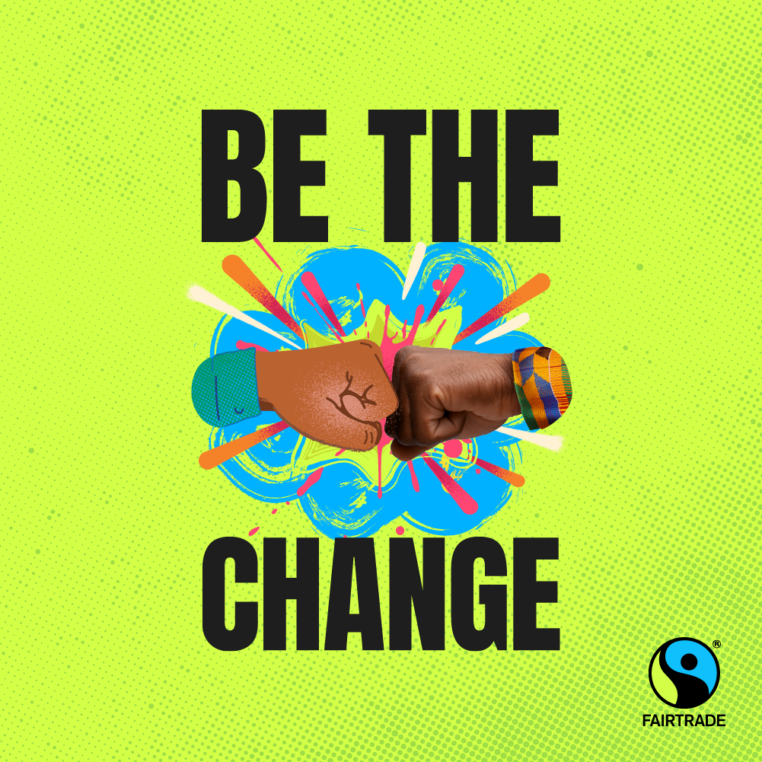
3 ways to be the change with Fairtrade
Choose Fairtrade.
Urge your local MP to sign the Be the Change pledge.
Spread the word.
Notes:
So how are we asking people to be the change with Fairtrade? Three simple ways. We will look at this in more detail shortly, but put simply.
Choose Fairtrade. Because when farmer and workers get a fairer deal, they can do more to build a fairer future.
Urge your local MP to sign the Be the Change pledge. Because politicians can help change laws and regulations to make all trade fairer.
Spread the word. Because more people choosing Fairtrade and campaigning on fair trade issues means we’ll make change faster.

Slide 3
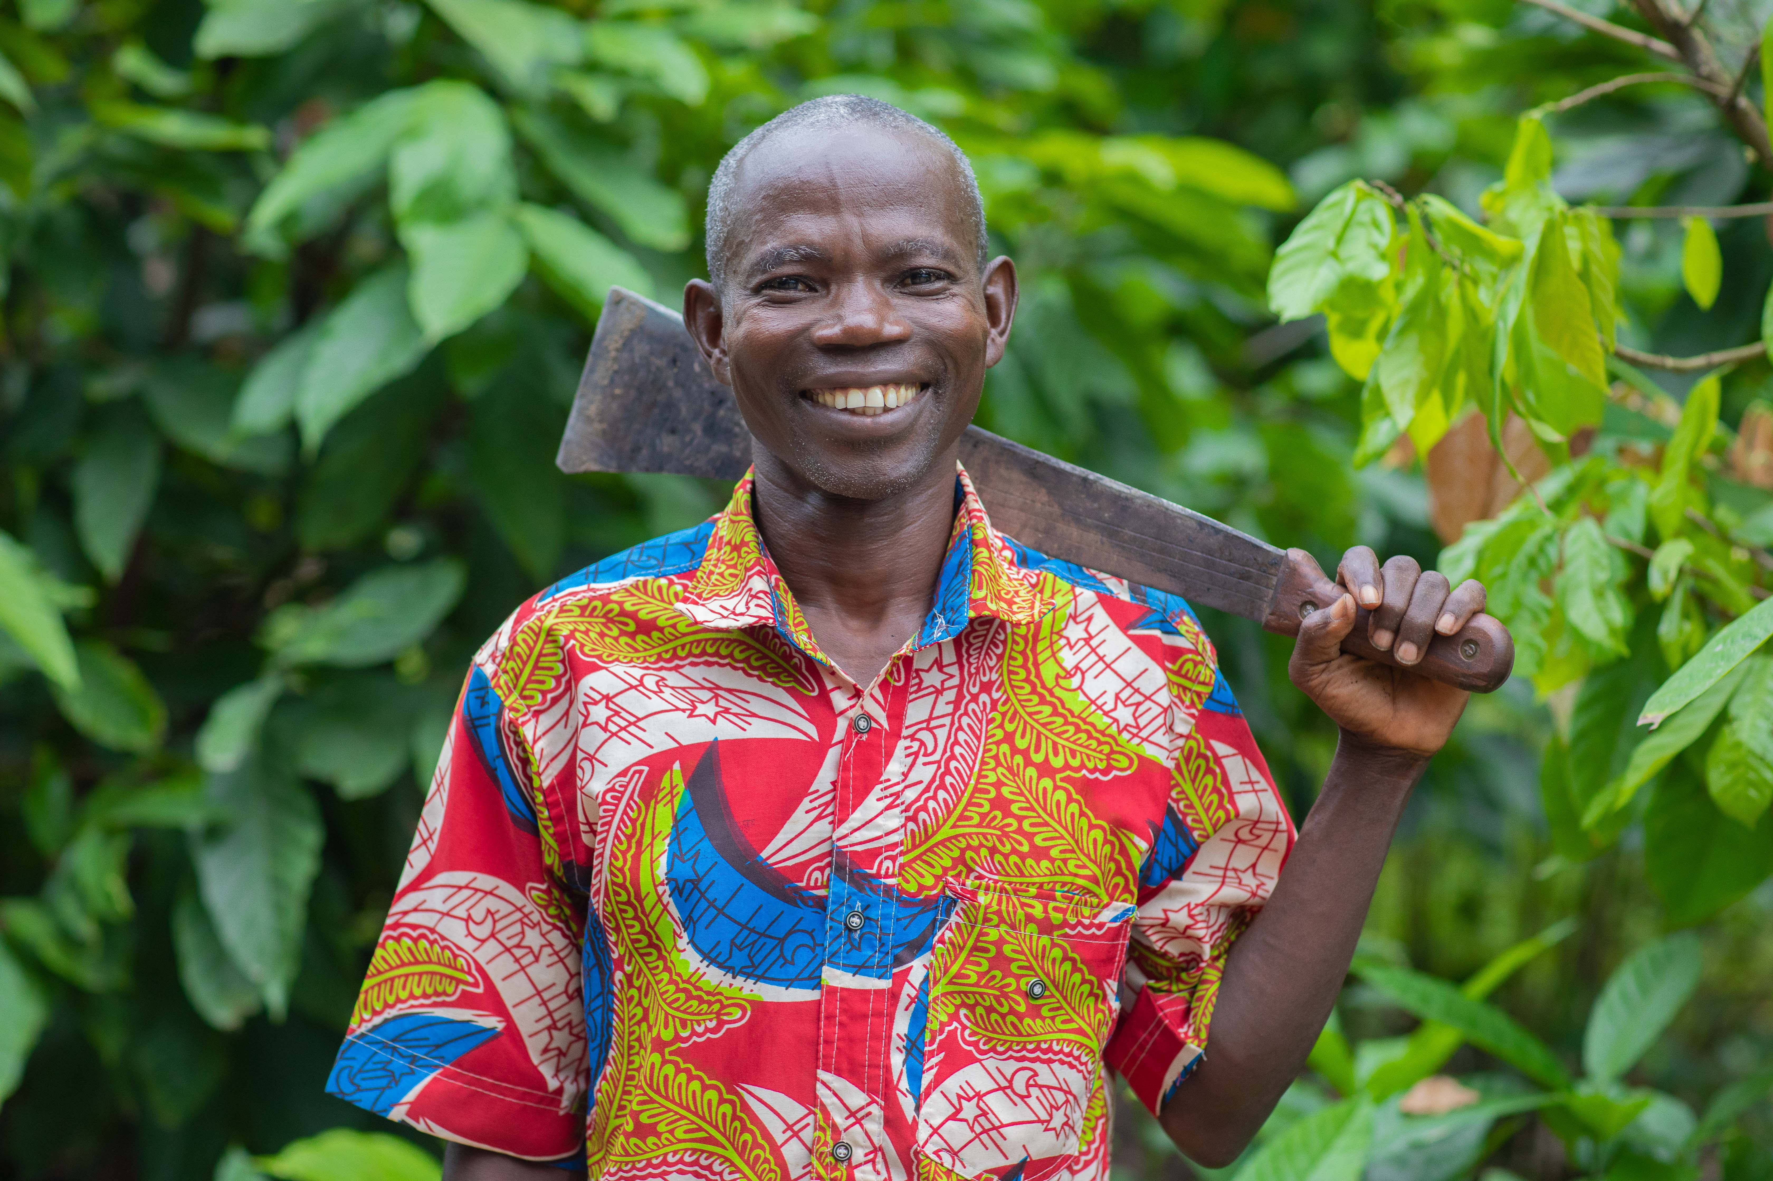
Meet Dabillia Mathieu
Notes:
We’ll talk more about the ways you can support Fairtrade in a moment. But now I want to focus on the difference Fairtrade can make.
And part of Fairtrade is always putting the farmer’s perspective first. So let me introduce you to Dabilla Mathieu, Fairtrade Cocoa Farmer with ECAMON Fairtrade co-operative, Côte d'Ivoire.

Slide 4
‘I did not have the chance to continue my studies, but with ECAMON and our plantations, I can pay for the children's studies. This is my pride, because the children are the future.’
Dabilla Mathieu, Fairtrade Cocoa Farmer with ECAMON Fairtrade co-operative, Côte d'Ivoire.
Notes:
Dabilla is a Fairtrade cocoa farmer at the ECAMOM cooperative in Côte d’Ivoire. He has been a cocoa farmer for over 30 years, and his greatest pride are his children.
And it’s easy to understand that pride when you appreciate Dabilla himself was not able to complete his education, as he could not afford to do so.
Now his children go to schools directly built by Fairtrade Premium funds. And the extra income he’s been able to earn through being part of ECAMON, the Fairtrade-certified co-opertative he has been a part of over 30 years, means he can do more to ensure his children have greater opportunities in future.
Dabilla community has also used Fairtrade Premium funds for important projects like a water pump to ensure safe access to clean water and building a communal canteen.

Slide 5
Dabilla’s story is one of millions
This year marks 30 years of Fairtrade sales in the UK
The huge growth in Fairtrade sales in that time also means a huge growth in Fairtrade impact
Notes:
Dabilla has been a cocoa farmer for 30 years, and coincidentally Fairtrade itself is celebrating the big 3-0 this year. It’s 30 years since the first Fairtrade products went on sale in the UK.
From humble origins 30 years ago, there are now around 5,000 Fairtrade products available to buy in the UK. When you choose any one of those, you are choosing to back a fairer deal for farmers and workers disadvantaged by our unfair global trade system.
Let’s look at a few stats on what that means.

Slide 6
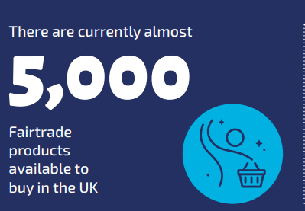
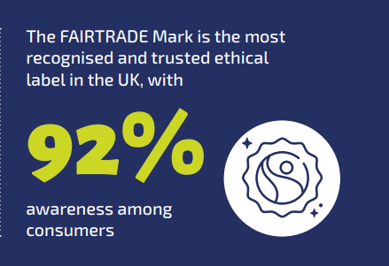
30 years of Fairtrade in numbers
Notes:
The growth of Fairtrade over 30 years has been extraordinary.
(Run through some of the numbers)
And most importantly, this growth has meant more farmers with more resources to drive the change they want to see in their communities. To get an idea of what that looks like, let’s look at the growth in Fairtrade Premium payments to Fairtrade farmers and workers.

Slide 7
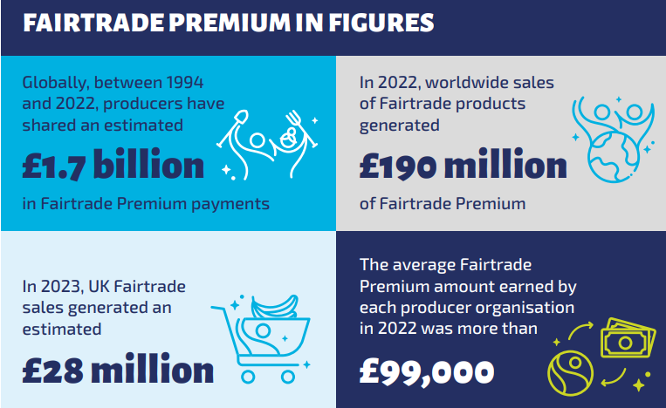
Notes:
First of all – what is the Fairtrade Premium? (Could ask audience as a question)
The Fairtrade Premium is an extra cash payment received by groups of farmers and workers on top of the price they receive for their goods or crops. The farmers and workers involved then democratically decide how to invest this money. It could be in health care facilities, schools or in making their business more sustainable.
We believe the best way to ‘be the change’ is to make sure farmers and workers have more power, more income and more opportunity to drive the change they want to see in their local communities. And over the past 30 years, every time you have picked up Fairtrade, you have been a part of that.

Slide 8
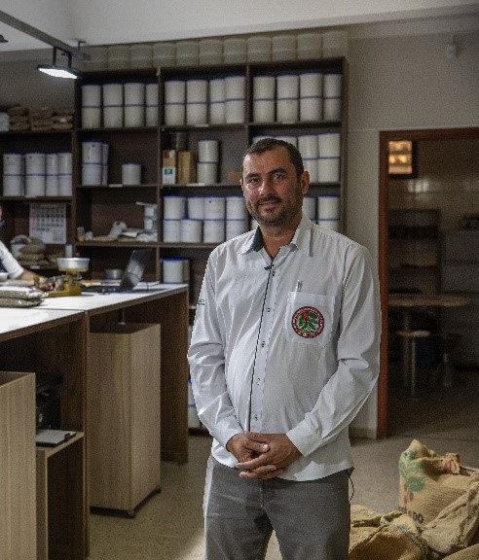
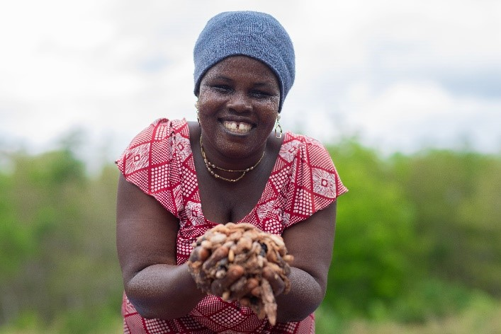
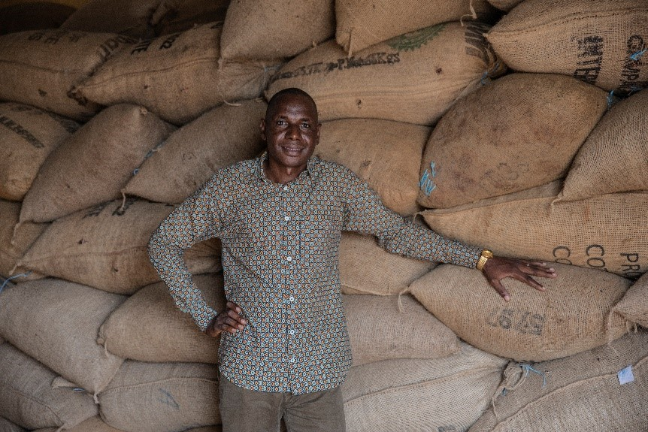
Behind every number is a story like Dabilla’s
“We have been able to build a school, accommodation for teachers of the school. We have renovated the hospital… all of this with the Fairtrade Premium. Without Fairtrade we wouldn’t be in this position.”
Bengaly Bourama, Fairtrade Cocoa Farmer, Côte d’Ivoire
“Fairtrade has changed my life. Indeed, in a crisis situation, I have an inflow of money for my needs instead of taking credits.”
Kouassi Affoué Angèle , Fairtrade Cocoa Farmer, Côte d’Ivoire
The cooperative, through the premium, has its own nursery. We do a mapping of the species that are at risk of extinction…[and] several springs have recovered.”
Eliezer Reis Jorge, Fairtrade Coffee Farmer, Brazil
Notes:
The millions of farmers in the Fairtrade system, and the thousands of Fairtrade chocolate treats now available, may be difficult to comprehend.
But all we need to remember is behind those numbers are tens of thousands of stories like Dabilla’s. People who have been able to tackle poverty and inequality by using the power of Fairtrade.
Kouassi not only used the extra income from Fairtrade to avoid falling in to debt. She also learned “learned several things about women's rights, how to be a good leader to manage a group in order to reach the objectives, maintain the cohesion of the group, diversify the plantations.” These extra benefits Fairtrade can offer beyond income can be really important – strengthening co-operatives, communities and tackling gender inequality.
Eliezer’s story of replanting trees is a great example of many Fairtrade farmers commitment to protecting the environment and taking on the devastating effects of climate change, which are putting lives and livelihoods at risk right now all across Africa, Latin America, Asia and the Pacific. Smallholder farmers in these areas did the least to cause climate change, but feel it’s worst effects. But farmers like Eliezer are doing everything they can to build a more sustainable future. His quote is a clear example of the simple truth that with fairer pay, farmers like him could do even more to protect their environment.
Bengaly’s quote shows the breadth of the benefits Fairtrade can offer – and how the extra income the Fairtrade Premium can offer. It can help secure what we could consider the essentials for communities around the world – access to decent health care, having trained teachers in our schools.

Slide 9
Want to be the change by backing farmers like this?
Here’s how to do it…

Slide 10
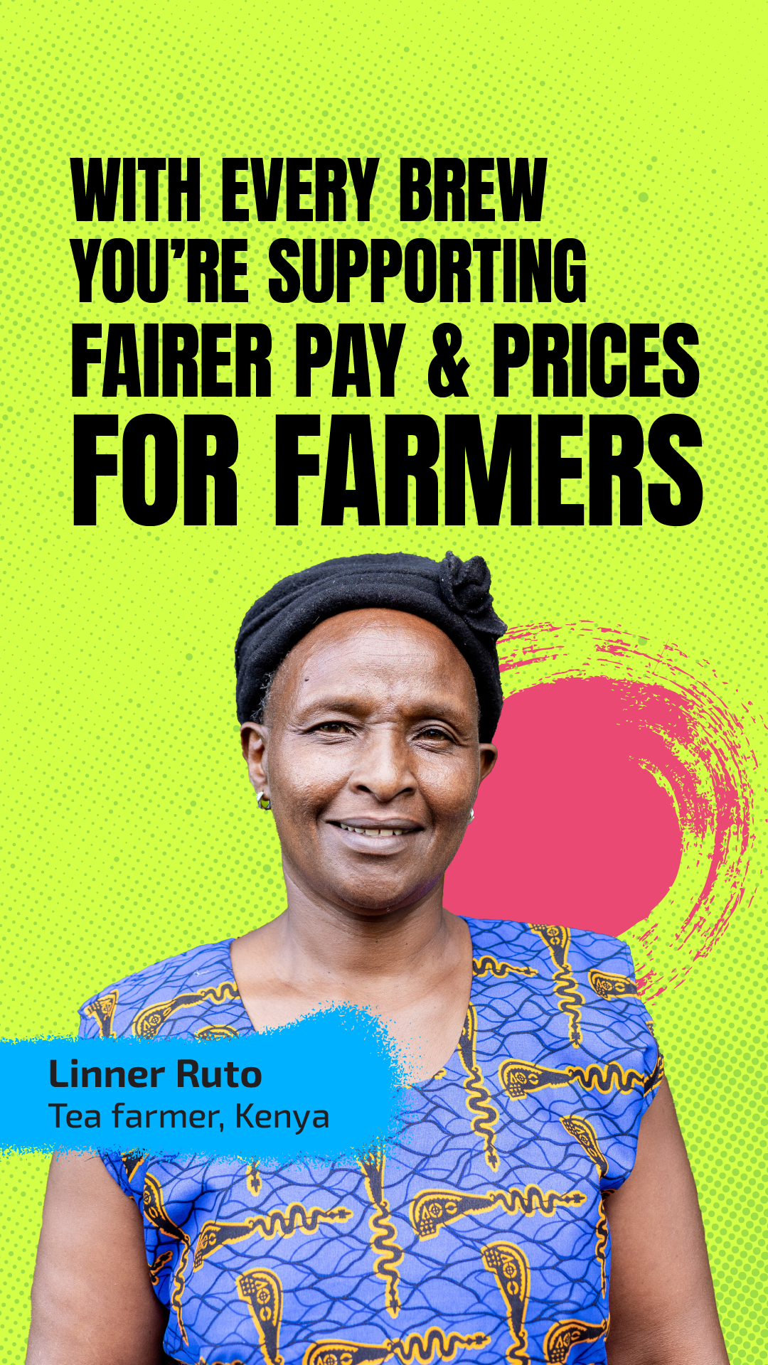
1: Choose Fairtrade
Choose fairer pay
Choose a fairer say
Choose products produced in line with the Fairtrade Standards
Check out our website to see some of the 5,000 Fairtrade products available in the UK!
Fairtrade is about a fairer deal for farmers – it doesn’t have to cost you more
Notes:
The good news is if you – like most people in this country – choose Fairtrade, you are already part of these stories.
Choosing Fairtrade has never been easier with over 5,000 Fairtrade products available in the UK. And choosing Fairtrade doesn’t need to mean choosing more expensive products, with supermarkets including Co-Op, Lidl and Aldi running own brand lines of coffee and chocolate, as well as good value Fairtrade refreshments being available at outlets like Greggs. Fairtrade is about what the farmer is paid, not what you pay.
None of what we have discussed would be possible without people like you choosing Fairtrade. Income and opportunities from Fairtrade sales has helped power the work of farmers like Dabilla and Kouassito deliver generational change for their families.
As well as the benefits of the Fairtrade Premium described earlier, Fairtrade offers farmers the security of the Fairtrade Minimum Price – a safety net which provides a guarantee that they will never be paid below a particular price, even if the market crashes, as it often does in the commodities we work in.
Fairtrade’s democratic and transparent structures also offer producers a fairer say. Decisions on spending Fairtrade Premium are made democratically be workers committees and Fairtrade Co-operatives. The Fairtrade Standards promote gender equality, human rights and tackle all kinds of discrimination. And the simple act of coming together in a co-operative group gives small-scale farmers a bigger voice when working with large multi-national companies.

Slide 11
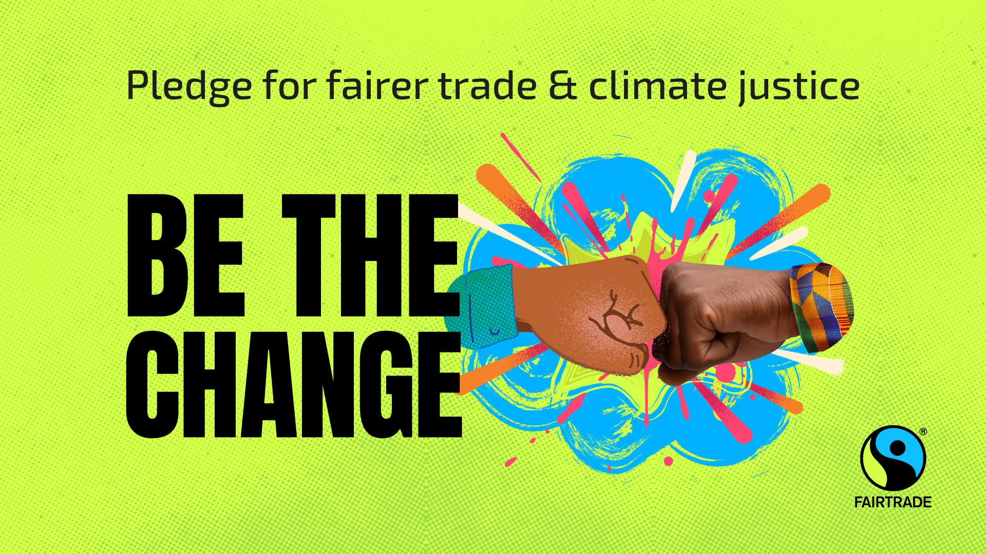
2: Ask your MP to sign the Be the Change pledge
We can all Be the Change – but MPs have a special role to play
Ask your MP to sign the Be the Change pledge
Use our simple online tool, or invite them to an event
The Be the Change pledge will run to the end of the year
Notes:
Every one of us can Be the Change by choosing Fairtrade but politicians have a special role to play.
By changing laws and regulations, MPs can help make all trade fair.
So as Fairtrade Fortnight begins, we are asking you to call on your MP to sign the Be the Change pledge.
Visit our website or sign-up to our emails for a quick and easy way to contact your MP. And of course invite your local MP to events like this.
Because your voice really matters to MPs – and initiatives like this really make a difference
Before the election, over 1500 of you contacted your local candidates, and we saw real results. Over 200 candidates committed to work with fair trade campaigners like you locally, and organisations like ours nationally.
Over 20 of those people are now MPs, ready and willing to speak up for a fairer future.
But with the government committing to introduce a new trade strategy, we need as many voices as possible, from all political parties, speaking up for farmers like Dabilla. With over 350 new MPs since this is a great time to build political support for Fairtrade.
And don’t worry if you can’t get involved during Fortnight itself, the Be the Change campaign will run until the end of 2024.

Slide 12
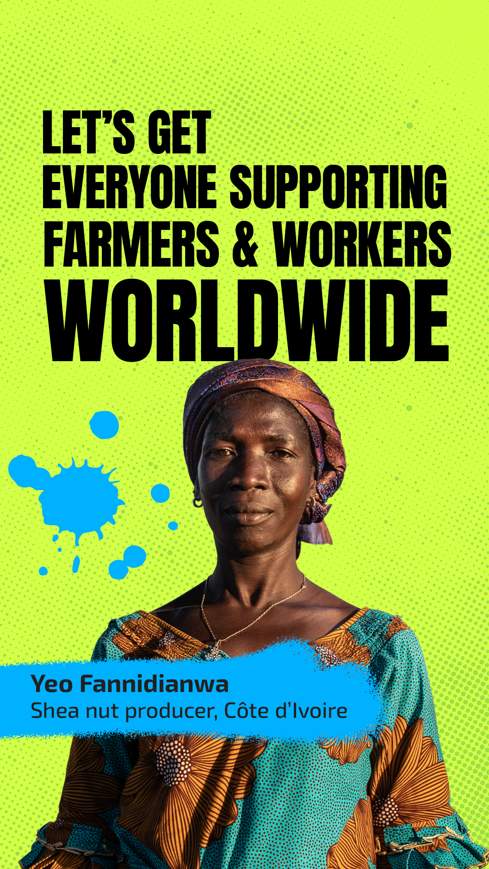
3: Spread the word
More of us choosing Fairtrade = more power and more income for farmers
More of us demanding politicians make all trade fair = trade justice pushed up the political agenda
Connect with Fairtrade Communities in your area
Notes:
Finally, spreading the word on Fairtrade is what Fairtrade Fortnight is all about. It’s not just raising awareness – it’s raising active, practical support for a fairer future.
For farmers like Yeo featured here, Fairtrade is a tool they can use to build the future they want to see, to change their community and business for the better. If more of us choose Fairtrade, that tool is more powerful and farmers like Yeo can do even more.
And as mentioned our new intake of politicians need to hear how much Fairtrade matters to communities like you – farmers like Yeo won’t have the direct connection to politicians in wealthy nations like the UK, so we need to make sure their voice is heard. Only then can we convince them to start shaping the future of trade for the better.
Want to get more involved? Check out the details of how to get involved with one of our over 1200 Fairtrade Communities.

Slide 13
Thank you for being the change! Questions? hello@fairtrade.org.uk
Notes:
Thank for listening! Visit the Fairtrade Foundation website for more ways to get involved, including a quick way to ask your MP to get involved and lots of guidance on where to buy Fairtrade products.

