Slide 1
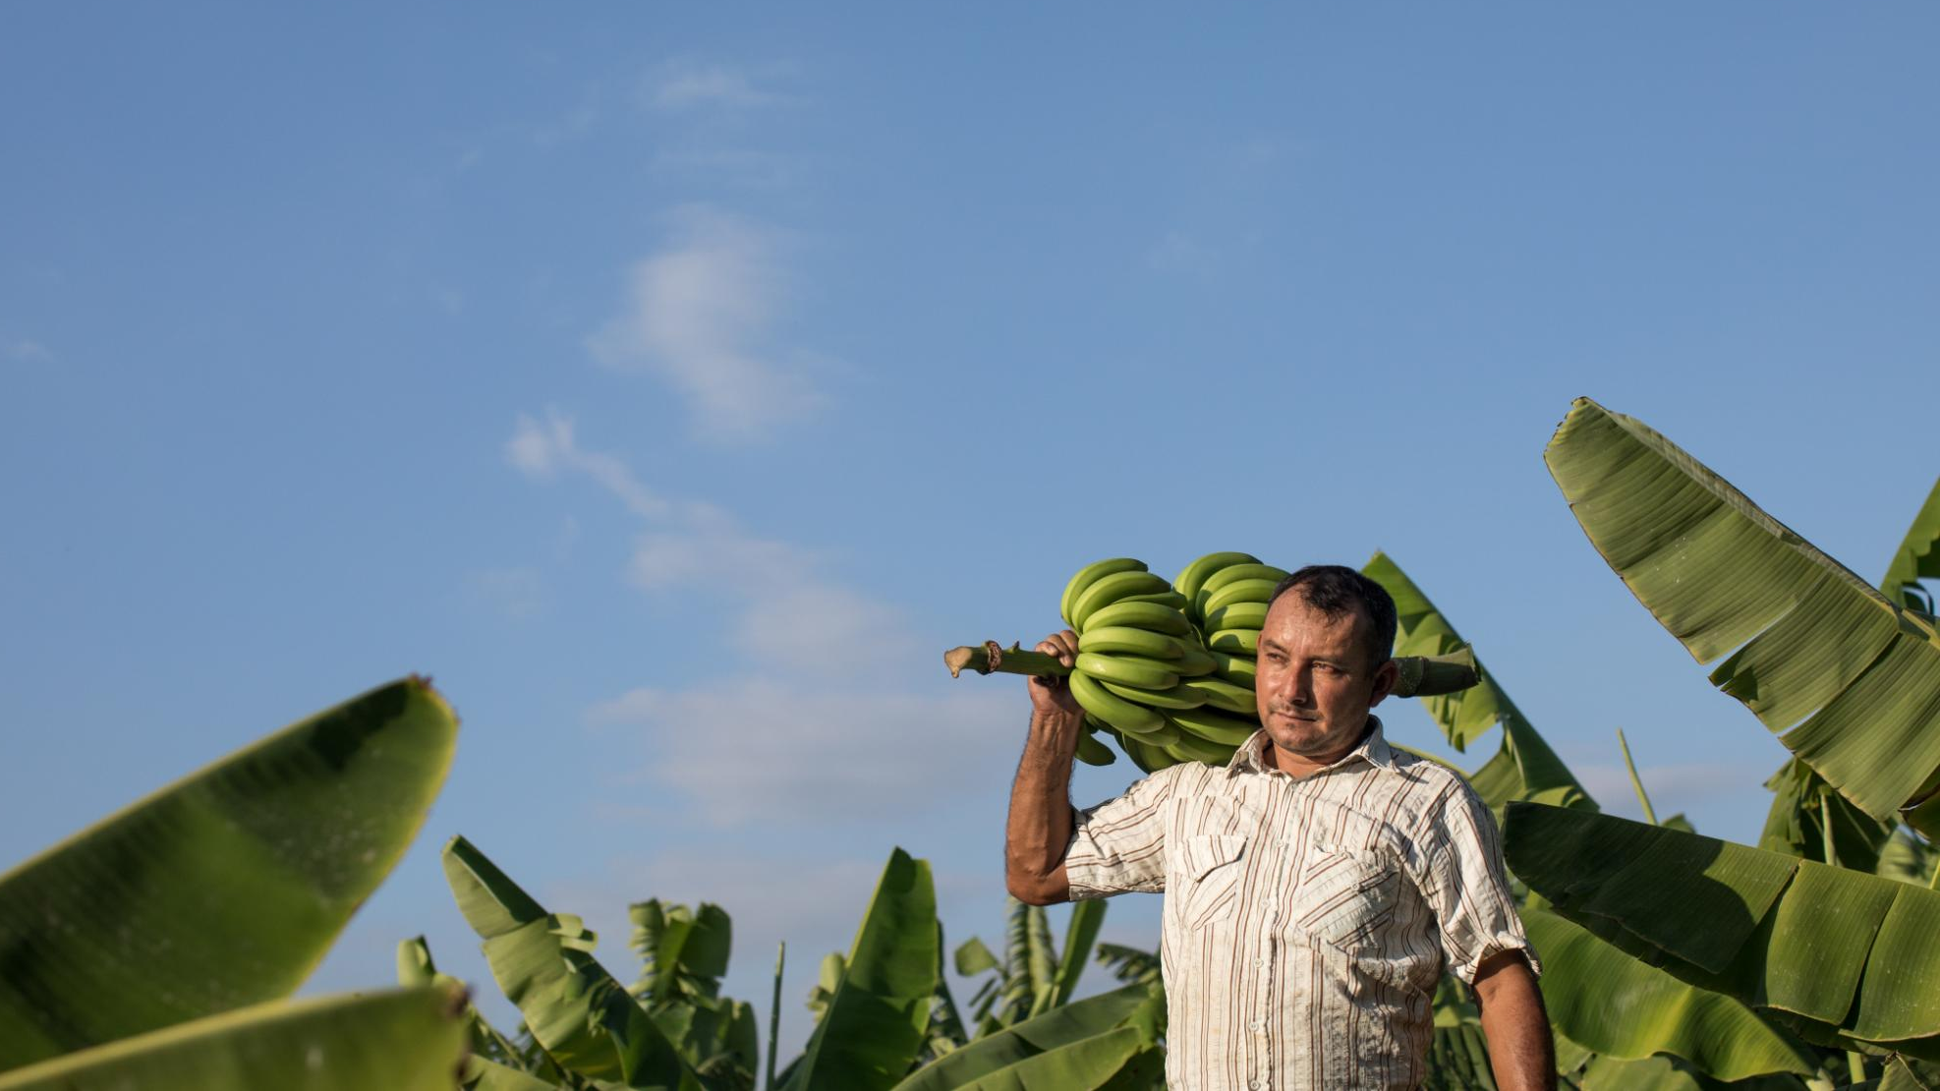
Campaigner Toolkit
Fairtrade Fortnight 2023
Notes:
Photograph of banana farmer Roberto Gallo in La Noria, Piura, Peru. Photograph credit: Ángela Ponce, 2021.

Slide 2
Contents
Why Fairtrade Fortnight?
Key messages 2023
The campaign: The endangered isle
Resources
Actions
2

Slide 3
What's Fairtrade Fortnight all about in 2023?

Slide 4
This Fairtrade Fortnight, join us in spreading one simple message: Making the small switch to Fairtrade supports producers in protecting the future of some of our most-loved food and the planet.

Slide 5
Fairtrade Fortnight 2023 focuses on the future of food
Did you know coffee, bananas and chocolate could soon be much more difficult to find on our shelves?
Climate change is making crops like these harder and harder to grow. Combined with deeply unfair trade, communities growing these crops are being pushed to the brink.

Slide 6
Key messages 2023 – Climate and the future of food (full key messages here)
Fairtrade Fortnight this year will highlight the urgent threat to the future of the foods we love and the livelihoods of the people who grow them, as they face the worst effects of the climate crisis. Without our support for fairer prices today, farmers will find it even harder to tackle the climate and economic challenges of the future.
Smallholder farmers simply can’t foot the bill for adapting to economic and climate change on their current incomes. This fortnight and beyond, Fairtrade is asking shoppers to act now and choose Fairtrade to back the farmers behind some of our favourite products to ensure they are paid fairly and can keep farming through these extremely tough times.
Whatever your budget and wherever you shop, consumers can choose Fairtrade products today to support farmers by ensuring they have fairer pay to face the climate crisis and continue producing the foods we love.
By choosing Fairtrade now, you’re taking a stand with farmers and workers worldwide for fairer incomes, so together we can protect the future of our food.

Slide 7
Key messages 2023 – Cost of Living (full key messages here)
The current financial crisis is taking a heavy toll on smallholder farmers and workers, with the costs of fuel, fertiliser and food all increasing beyond what is affordable. If they aren’t getting a fair price to cover their costs at this critical time, it means they won’t be able to grow food in the future.
A fair income for farmers and workers is vital now, not only so they can keep farming, but so they can afford to invest in making changes to adapt to the worsening climate and economic crises. It’s simply not fair to expect them to do both without our support.

Slide 8
Key messages 2023 – Community Campaigning (full key messages here)
In every single Westminster constituency, Fairtrade campaigners have started Community Declarations of Solidarity in support of Climate Justice. These challenge local MPs to act on the support within their communities for fair, global action on climate change. Throughout Fairtrade Fortnight, campaigners will continue to collect signatures and meet with their MPs to establish to discuss how the UK can deliver on it’s promises made at COP27 and elsewhere to deliver fair funding for communities.
Sign and view the Community Declaration of solidarity on the Fairtrade Foundation website

Slide 9
The Endangered Aisle
To get public attention for the threat facing the future of our food – and the communities who grow it – we are running a special, one-off stunt: The Endangered Aisle.
The Endangered Aisle will shine a light on the supermarket staples most at risk of becoming endangered from the climate crisis, including coffee, bananas and chocolate.
As part of the launch, Fairtrade will release new research highlighting how climate change is endangering the future of supermarket staples grown by farmers overseas. These findings will be showcased at the Endangered Aisle and available on this website.
Please help us spread the word about the Endangered Aisle when it launches at the beginning of Fairtrade Fortnight. Follow us:
Facebook
Twitter
Instagram
email
or keep checking our website for more details.

Slide 10
Resources

Slide 11
Resources you can use include:
Presentations and scripts
Social media graphics
Farmer stories and images
New films on the theme of Fairtrade Fortnight
Template press release and media guide
Frequently Asked Questions
Fairtrade icons and logos to use in your campaign materials
Print-at-home posters and leaflets
Lots more!

Slide 12
Presentations and scrips
Download a presentation which summarises the key messages of Fairtrade Fortnight 2023.
There’s also a script to accompany the presentation, which is available in pdf or PowerPoint format.
Download from our website.

Slide 13
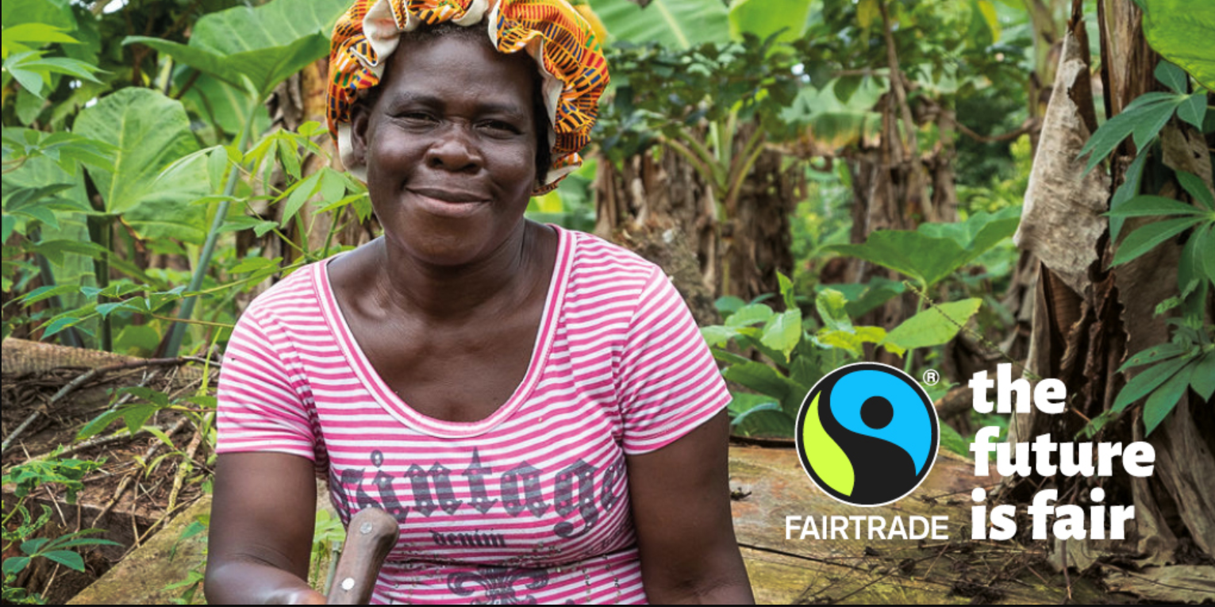
Farmer stories and social media graphics
A selection of graphics which you can use on social media to promote Fairtrade Fortnight.
Each graphic is based on a story of a Fairtrade farmer. You can also find a summary of their story alongside the graphics to help you tell their story authentically. Download from our website

Slide 14
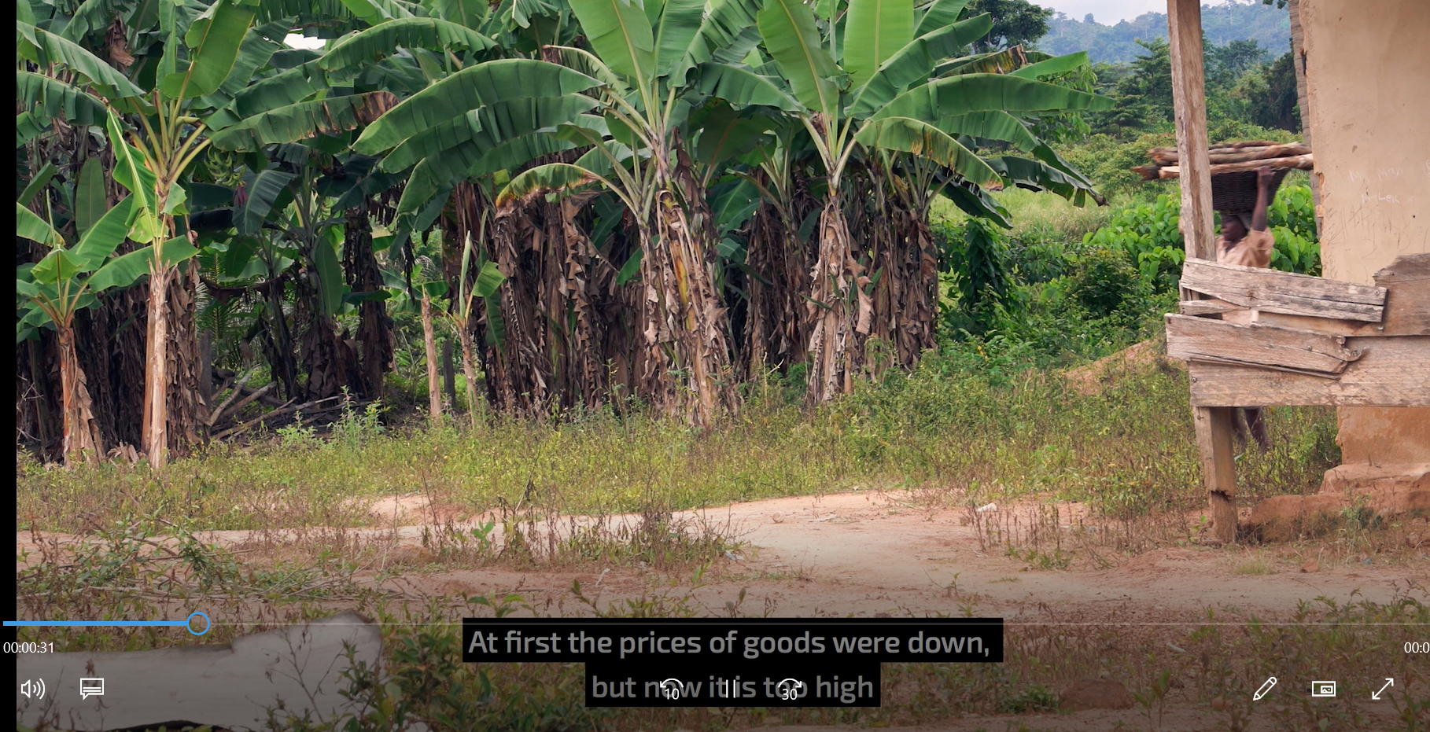
Fairtrade Fortnight films
Brand new film produced for Fairtrade Fortnight 2023, featuring Fairtrade cocoa farmers in Ghana. With a full four minute version and a short 59 second version for social media, you can use these to spread the word anywhere.
Each film highlights key themes of climate, sustainability and the benefits of choosing Fairtrade. You can download from our website or watch on Youtube.
Planning a Fairtrade Fortnight film night? Check out our Film Night Guide for other films you can show, and some suggested questions to get the discussion started.

Slide 15
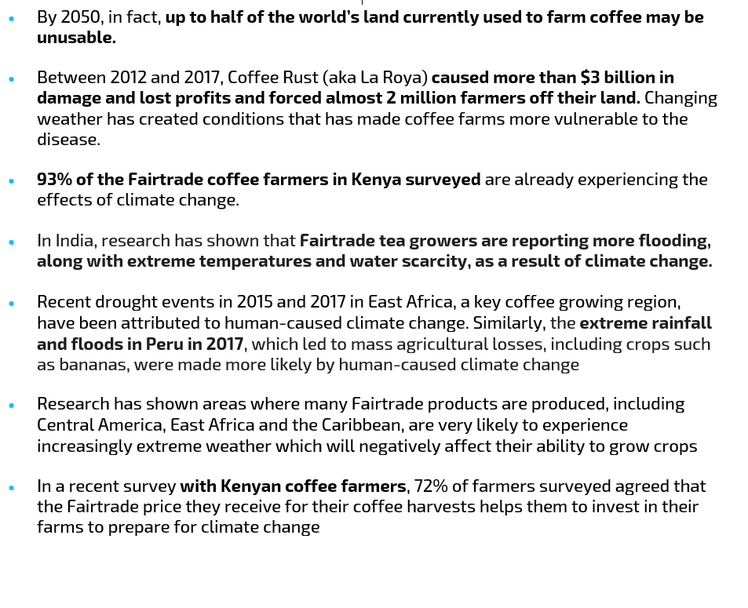
Key facts and figures
All the facts used in our presentation and script are sourced from our key facts and figures document, which includes sources for each statistic or piece of information. Download from our website.

Slide 16
Frequently Asked Questions
A list of Frequently Asked Questions that may come up when you talking about Fairtrade Fortnight.
We’ll keep this up-to-date throughout Fairtrade Fortnight so keep checking back for more info, or email hello@fairtrade.org.uk with any questions.
Download from our website.

Slide 17
Fairtrade Fortnight logos and icons
A selection of logos and graphics to help you spread the word on Fairtrade Fortnight, including versions with and without this year’s dates. Download from our website.

Slide 18
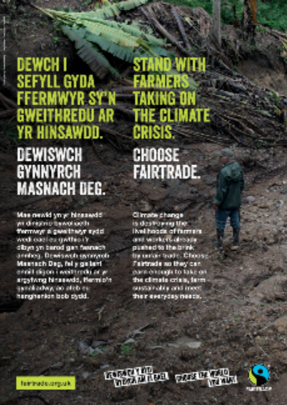
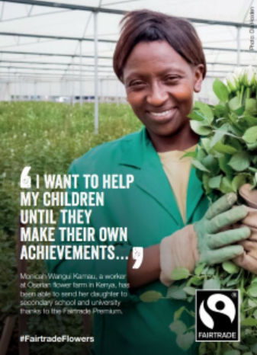
Print-at-home assets
Print a range of posters, leaflets and postcards to help spread word about Fairtrade Fortnight in your community. Visit the website to download and print.

Slide 19
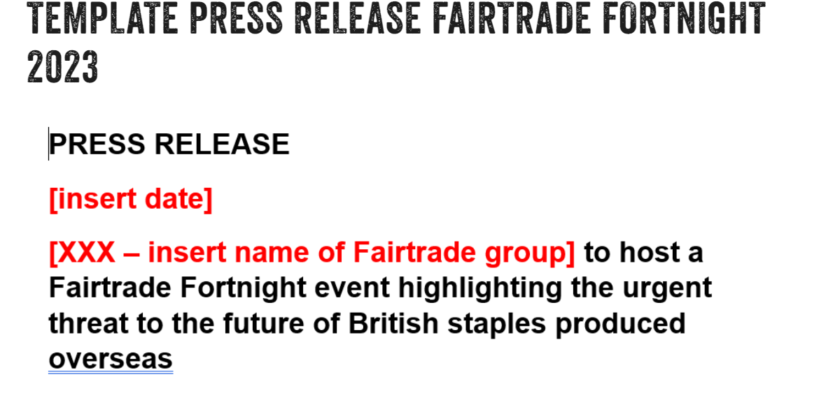
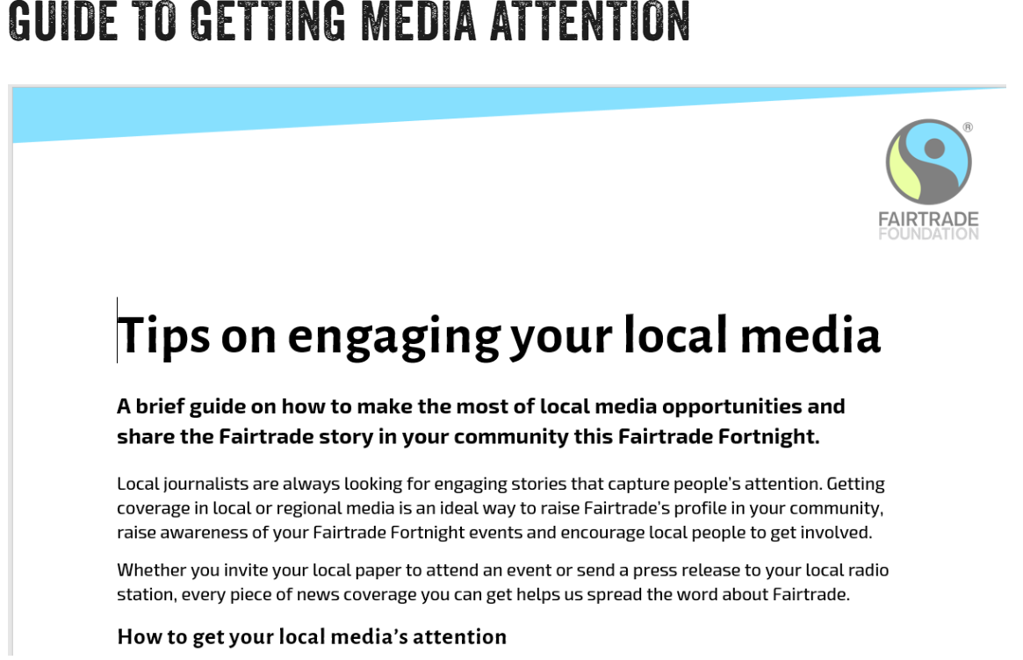
Get media attention
Read our guide to working with local media and adapt our template press release to get local and national media outlets to cover your excellent work.

Slide 20
More resources to run an event
Looking to run an event? Here’s a few resources to give you some inspiration!
Our Fairtrade Fortnight 2023 quiz: Test your knowledge – and those of your community – on all things Fairtrade and beyond with our special quiz.
Guide to a Fairtrade Film Night: Get people talking Fairtrade with our series of short films, including conversation starter questions and links to download for offline viewing.
8 event ideas from fellow campaigners: If you want more inspiration, check out this amazing selection of campaign ideas from Fairtrade campaigners.

Slide 21
Getting involved
Taking action & getting involved

Slide 22
Take action
Choose Fairtrade whenever you can. Choose to invest in the farmers doing amazing work to secure a sustainable future for food.
Spread the word. If more of us choose Fairtrade we can make an even bigger difference. Visit our social media channels, including Facebook, Twitter and Instagram, or sign up for emails by visiting fairtrade.org.uk/join
Make a Community Declaration of Solidarity. In every single UK constituency, Fairtrade supporters have started a Community Declaration of Solidarity for farmers taking on the climate crisis. Visit our Fairtrade and Climate Justice campaign page to sign and share today.
Notes:
So let’s end with three practical things you can do to take action
Choose Fairtrade whenever you can. Choose to invest in the farmers doing amazing work to secure a sustainable future for food.
Spread the word. If more of us choose Fairtrade we can make an even bigger difference. Visit our social media channels, including Facebook, Twitter and Instagram, or sign up for emails by visiting fairtrade.org.uk/join
Make a Community Declaration of Solidarity. In every single UK constituency, Fairtrade supporters have started a Community Declaration of Solidarity for farmers taking on the climate crisis. Visit Fairtrade.org.uk/ClimateJustice to join them today.

Slide 23
Join the Big Fairtrade Get Togethers
This year we’re bringing the whole Fairtrade movement together in seven different online Big Fairtrade Get Togethers.
With sessions for children of all ages and adults, they’ll be lots of opportunities to hear from experts, Fairtrade farmers and to ask questions in our interactive sessions.
Visit our website to sign-up now.
Remember to share after you sign up to help others hear about this great opportunity.
You can also join with your school, community group, friends or family and watch together!
Notes:
So let’s end with three practical things you can do to take action
Choose Fairtrade whenever you can. Choose to invest in the farmers doing amazing work to secure a sustainable future for food.
Spread the word. If more of us choose Fairtrade we can make an even bigger difference. Visit our social media channels, including Facebook, Twitter and Instagram, or sign up for emails by visiting fairtrade.org.uk/join
Make a Community Declaration of Solidarity. In every single UK constituency, Fairtrade supporters have started a Community Declaration of Solidarity for farmers taking on the climate crisis. Visit Fairtrade.org.uk/ClimateJustice to join them today.

Slide 24
Help us publicise your Fairtrade Fortnight activities
Over 400 amazing Fairtrade Fortnight events and initiatives are already planned all over the UK, all organised by people passionate about Fairtrade.
This year, we want to share as grassroots events as we can!
Please tell us about your event by adding the details to this online form.
By sharing on our social media channels we hope we’ll be able to get more people noticing your hard work. With so much activity, we won’t be able to share them all – but we’ll do our best to share as many as we can.
Notes:
So let’s end with three practical things you can do to take action
Choose Fairtrade whenever you can. Choose to invest in the farmers doing amazing work to secure a sustainable future for food.
Spread the word. If more of us choose Fairtrade we can make an even bigger difference. Visit our social media channels, including Facebook, Twitter and Instagram, or sign up for emails by visiting fairtrade.org.uk/join
Make a Community Declaration of Solidarity. In every single UK constituency, Fairtrade supporters have started a Community Declaration of Solidarity for farmers taking on the climate crisis. Visit Fairtrade.org.uk/ClimateJustice to join them today.

Slide 25
Thanks for making Fairtrade Fortnight special!
Please send any other questions to hello@fairtrade.org.uk

