Slide 1
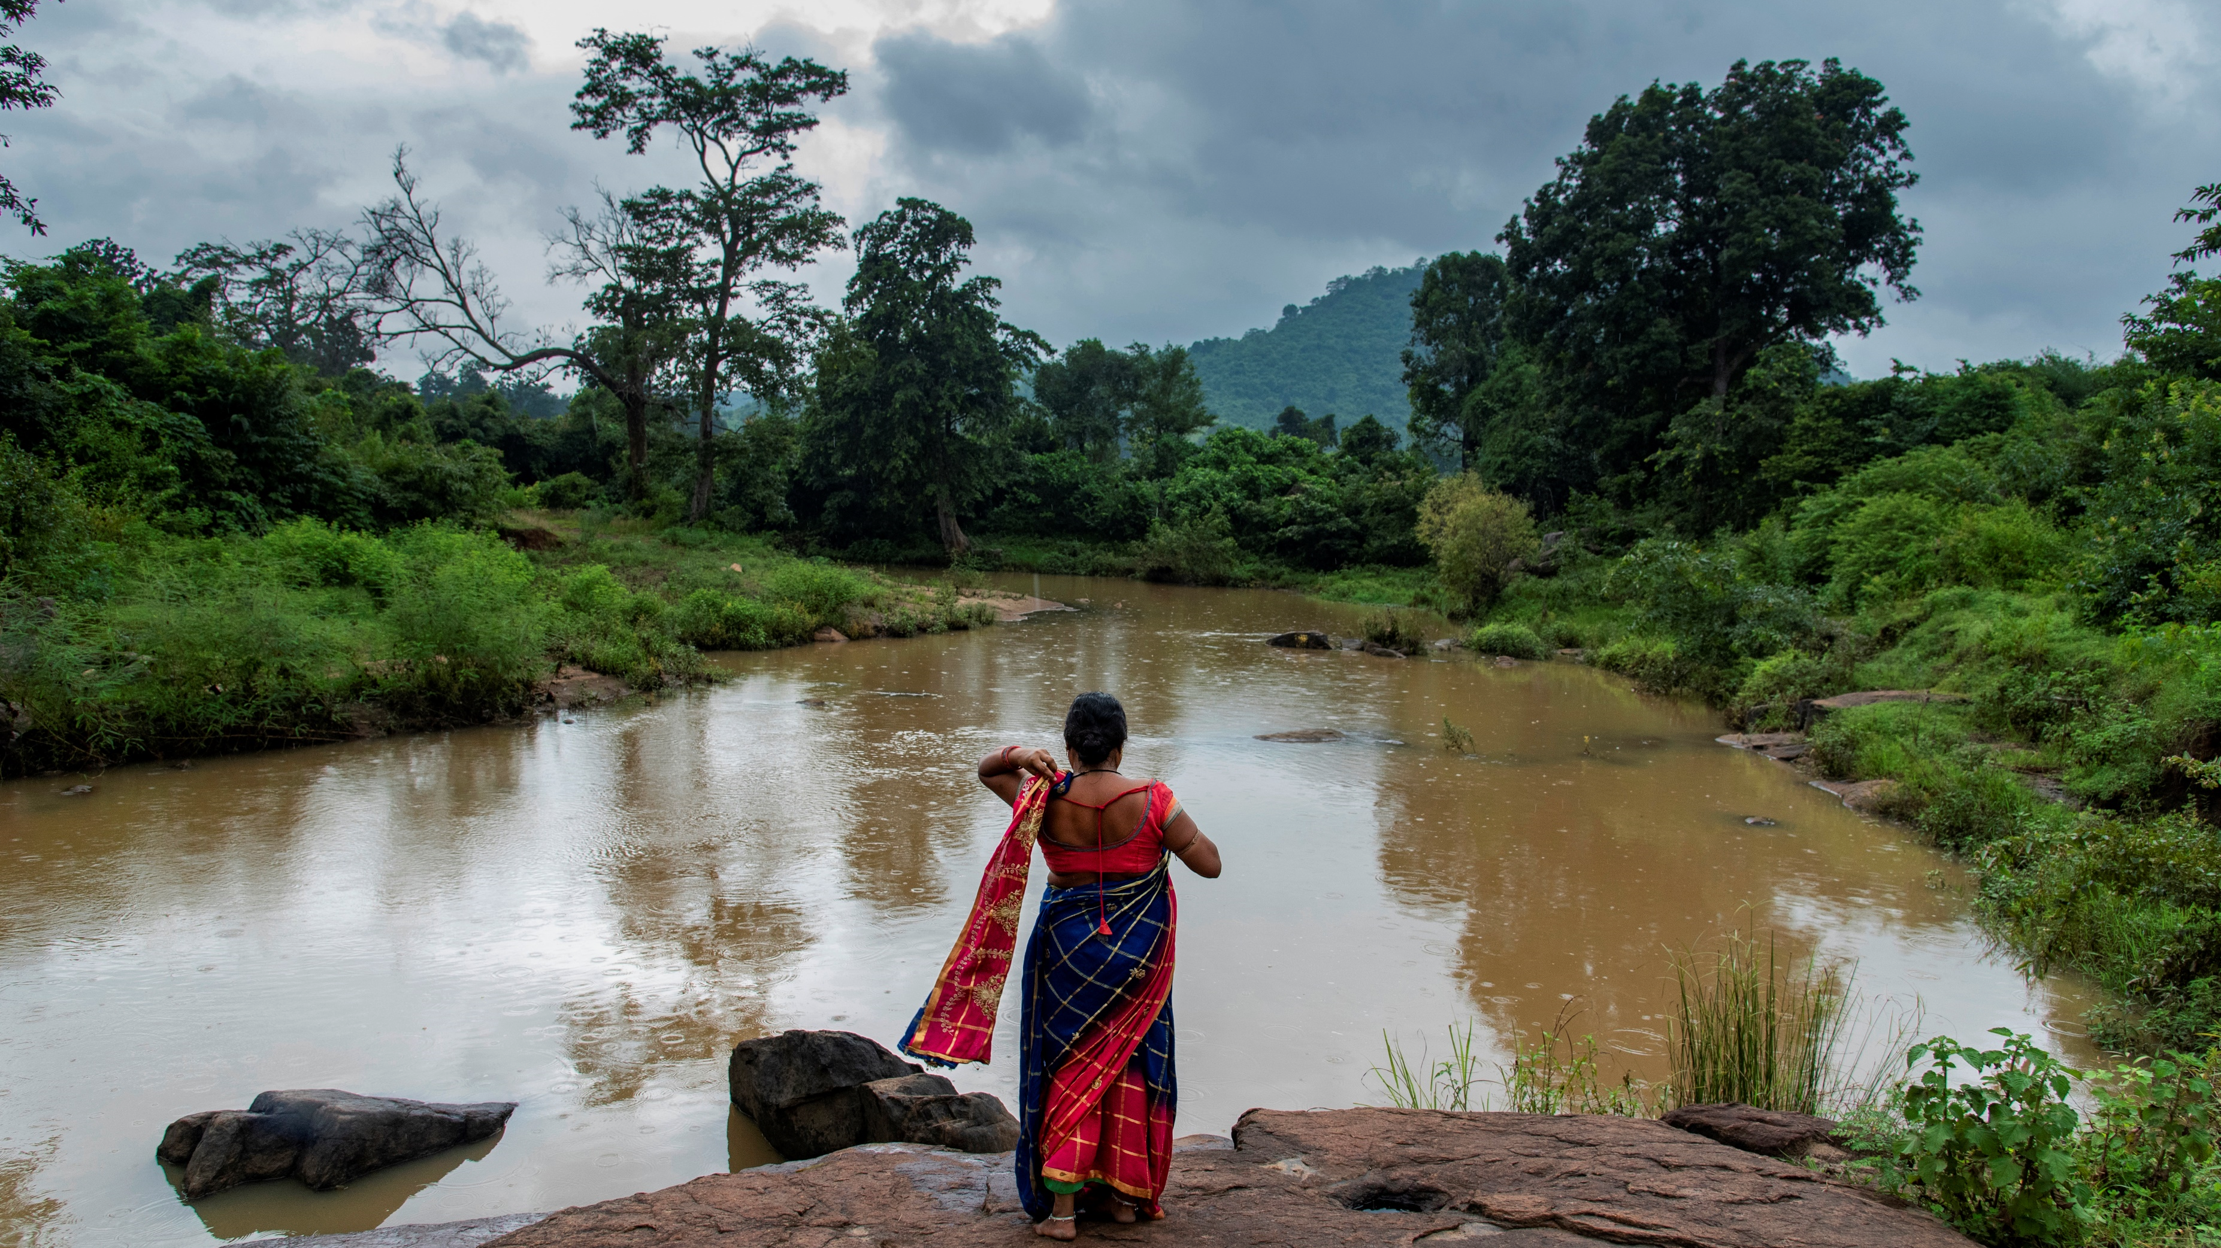
Protecting Forests with Fairtrade Farmers
Fairtrade Campaign Community presentation
Notes:
Photograph of cotton farmer Kamalini Nayak in Bachaka village of Bhawanipatna, Orissa, India. Photographer: Ranita Roy, 2021.

Slide 2
Tonight you'll hear
An update on our new climate justice campaign
More information about our new petition
How to use our brand new 'Climate Stories' resources
New videos from Fairtrade farmers, speaking about the effects of climate change and deforestation
And you'll hear from each other! Time for Q&A and discussion

Slide 3
Fairtrade & Climate Justice

Slide 4
Protecting Forests Campaign asks
Trade Justice
Campaigner activation 2:
Climate Justice
Deforestation

Slide 5
Protecting Forests- Fairtrade policy asks
Ask 1: UK Government meets commitment to provide £500million deforestation programming with money reaching farmers on the frontline
So that farmers are supported to tackle the root causes of deforestation and drive locally led solutions on deforestation.
Ask 2: Introduce deforestation legislation but with commitment to ensuring the costs and burdens of compliance are not imposed on farmers.
So that deforestation is outlawed in supply chains but not at the expense of farmers’ livelihoods and market access.

Slide 6
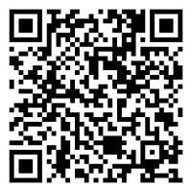
Protecting Forests- Fairtrade policy asks
Sign the petition here:
David Taylor, Senior Policy Manager

Slide 7
Deforestation & Protecting Forests with Farmers

Slide 8
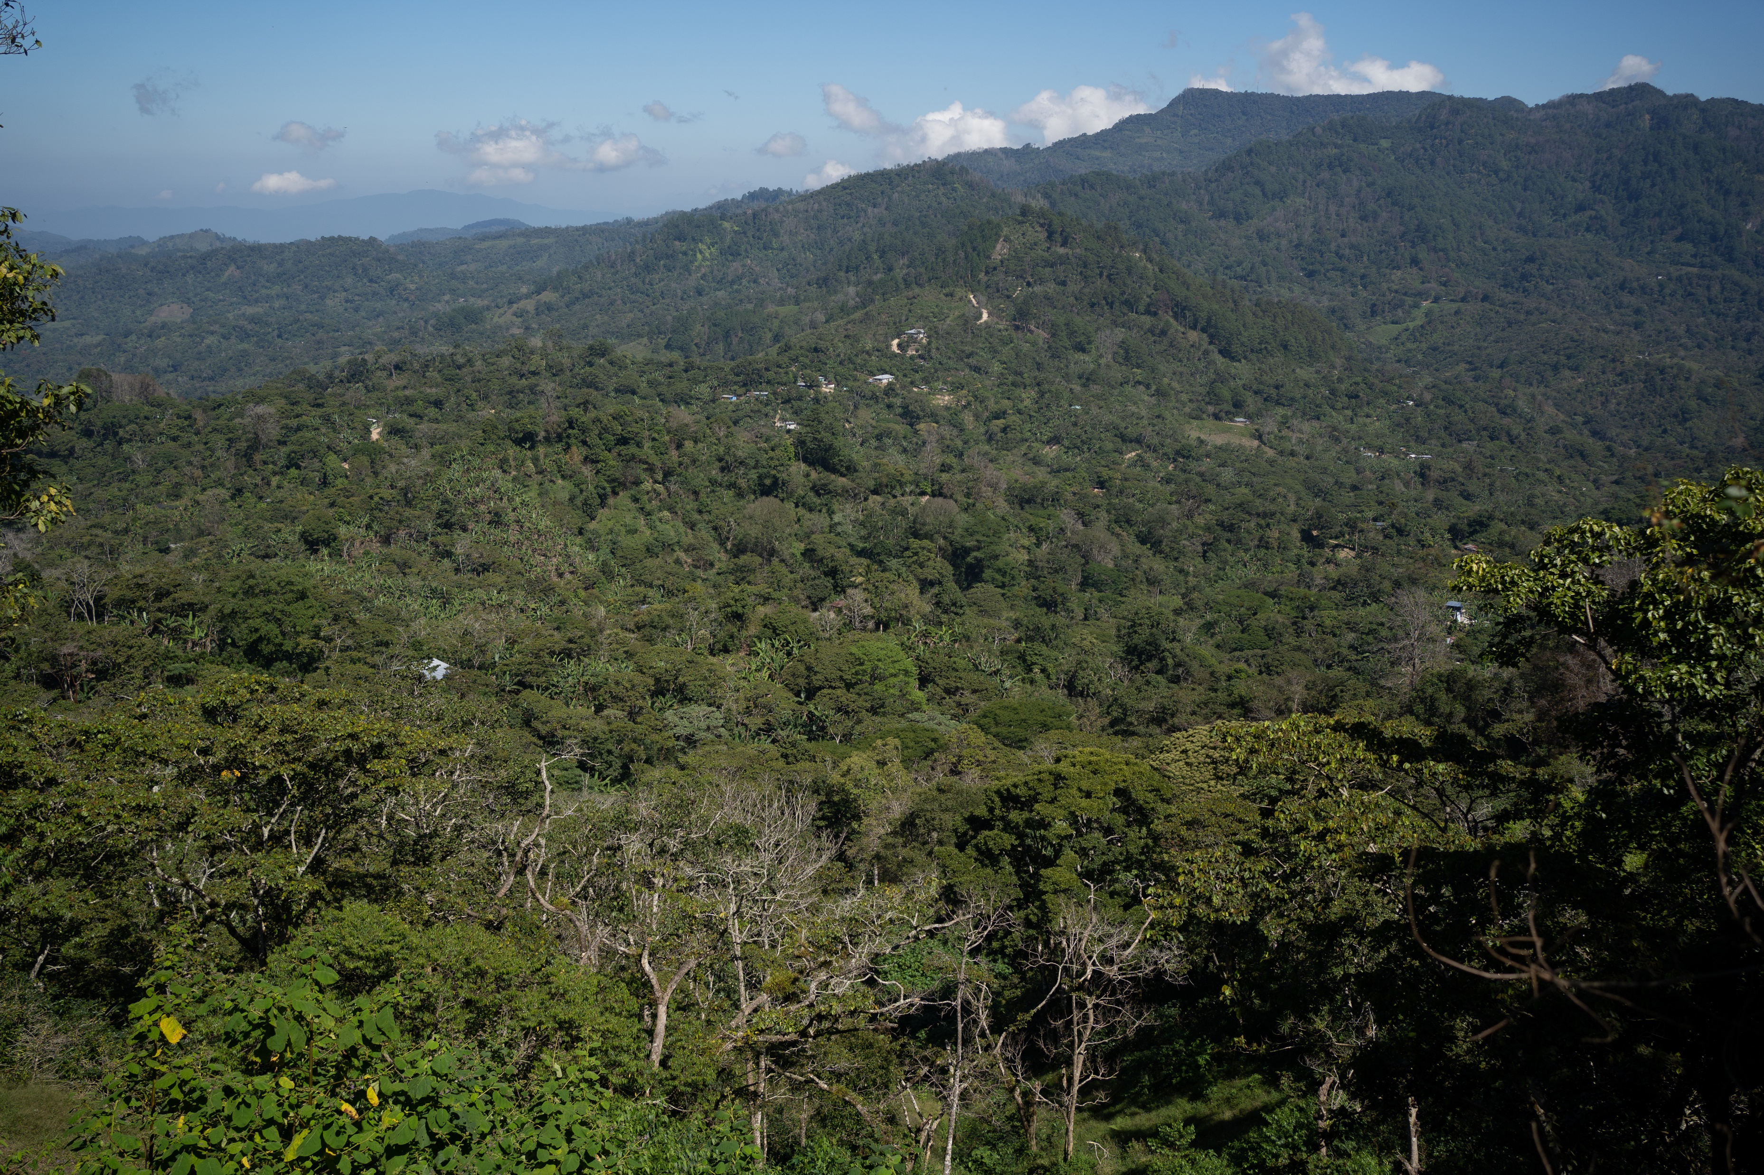
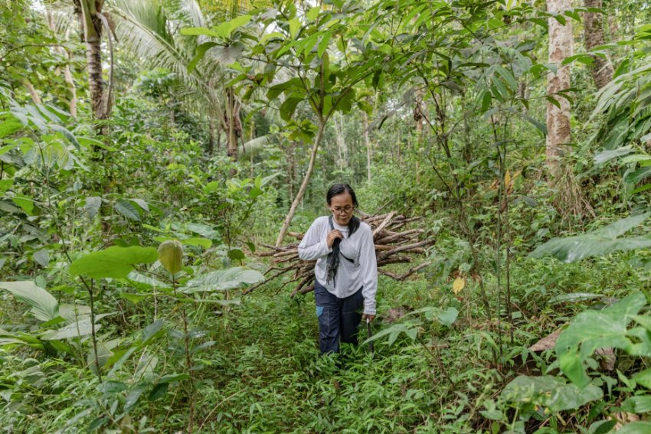
Why are forests important?
We all rely on forests.
Forests are home to around 80 percent of land-based animals and plants.
They generate the oxygen we breathe.
They have a vital role to play in the fight against global warming.
The mountains in Colinas, Santa Bárbara, Honduras
Coconut Sugar Farmer, Ponisih in a forest near her house in Hargorojo village, Purworejo Regency, Central Java, Indonesia.

Slide 9
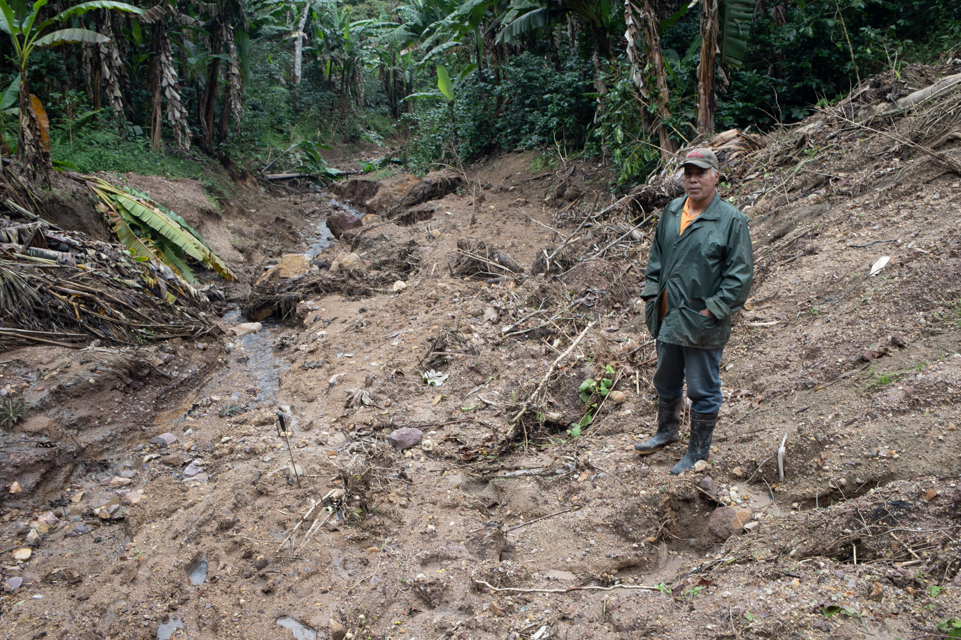
What are the biggest threats to forests?
Climate change
Expansion of agricultural land
Illegal logging
Infrastructure developments
Mining
Fire
Hector Hermilo Perdomo, COCASJOL, Colinas, Santa Bárbara, Honduras

Slide 10
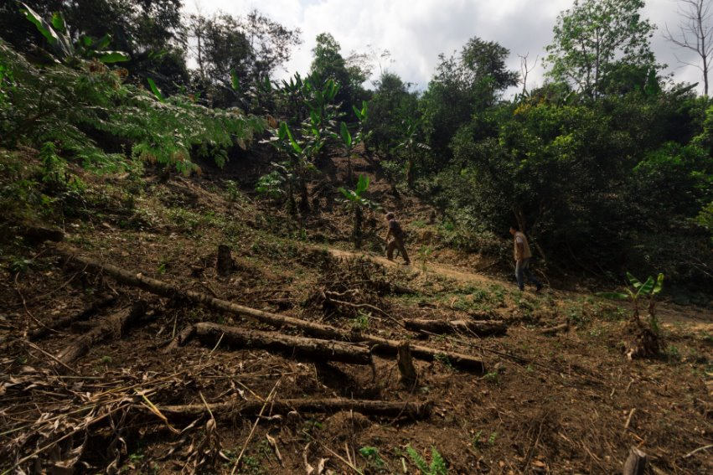
What is deforestation?
The world’s huge demand for wood, paper and agricultural products has led to some shocking and unsustainable management of forests.
Too many forests are being dangerously damaged, or completely destroyed.
Carrasco la Reserva, Bolivia

Slide 11
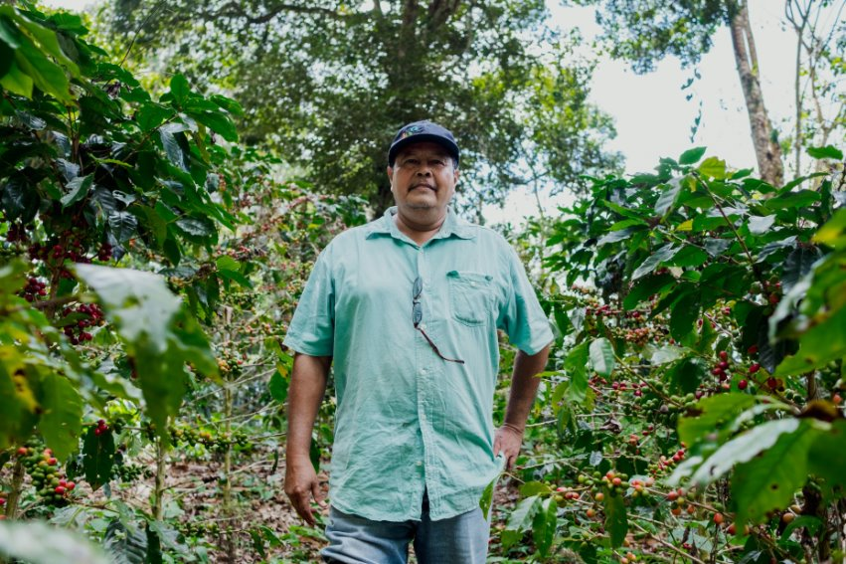
Fairtrade programmes that protect forests
Access to farm geolocation and satellite monitoring data and the tools for cooperatives to manage this data
Promotion of smallholder farmers as forest protector
Education about environmental risks
Training on agroecology principles
“My coffee, what is special about it is that, as you can see, it is grown in a primary forest. Here you will see the big trees that date back to, I mean, some are older than myself” - Adalid Hernandez, coffee farmer of COCAOL.

Slide 12
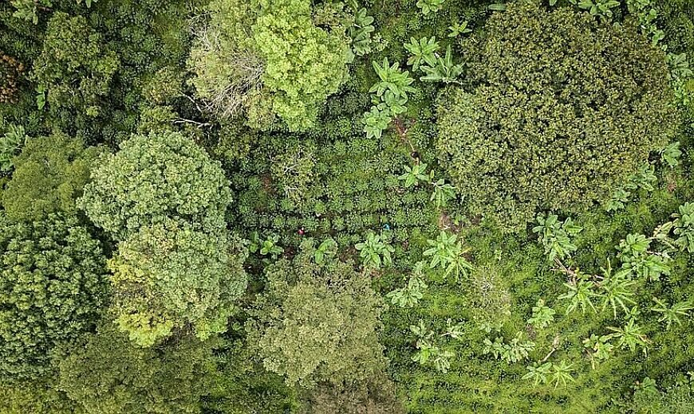
Geolocation and satellite monitoring
Since 2020, Fairtrade has been using geolocation. Fairtrade farmers collect and analyse data that can be used to monitor and prevent deforestation.
More recently Fairtrade has started using satellite monitoring that will help farmers track deforestation.

Slide 13
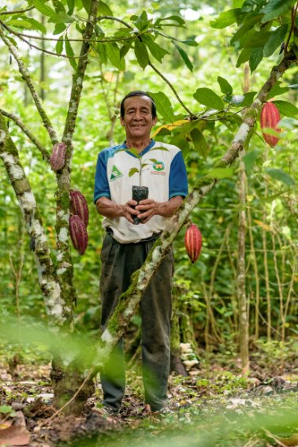
Promotion of smallholder farmers as forest protectors
Smallholders and the communities they live in are conscious of the value of forests to them and the wider global community. However, poverty can increase the risks to forests.
The Cooperativa ACOPAGRO is an organization of small specialty cocoa producers (organic and Fairtrade) in the Central Huallaga Valley, San Martín region – of Peru, with more than two thousand members.
Betman González Saavedra

Slide 14
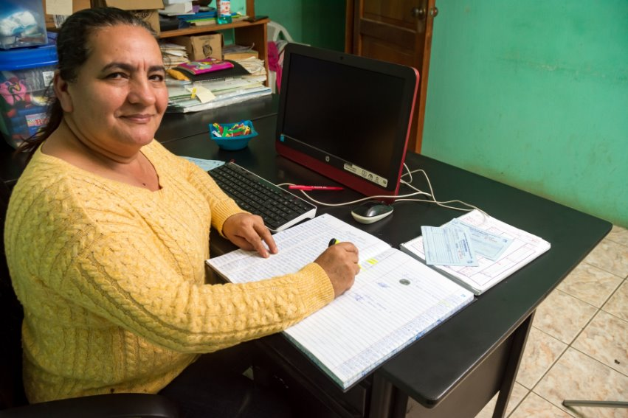
Education about environmental risks
Fairtrade is committed to climate education and strengthening smallholder farmers’ resilience.
One example of this is by establishing leadership schools in Bolivia, Ecuador, El Salvador, Guatemala and Nicaragua.
Fairtrade has trained 112 smallholder farmers in climate change and mitigation strategies including crop cover, use of organic fertilisers, drip irrigation and agroforestry.
Miriam Aracely Ipiña, from Gualán, El Salvador was selected to participate in the workshops of the School of Leadership

Slide 15
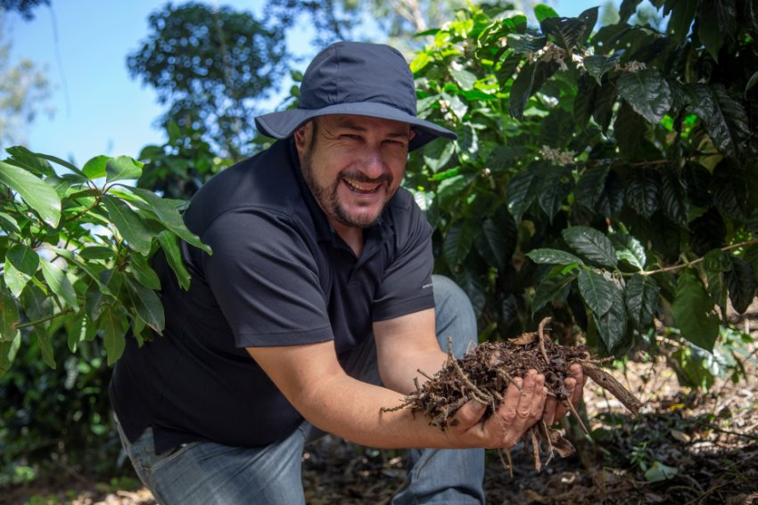
Training on agroecology principles
Through agroecology training thousands of Fairtrade farmers have benefited from knowledge and techniques for implementing agroecological practices, such as soil and water conservation practices, agroforestry and sustainable energy.
COOPELIBERTAD is well-recognized for its commitment to socio-environmental responsibility in the coffee industry, as evidenced by its significant certifications.

Slide 16
Spring Climate Stories

Slide 17
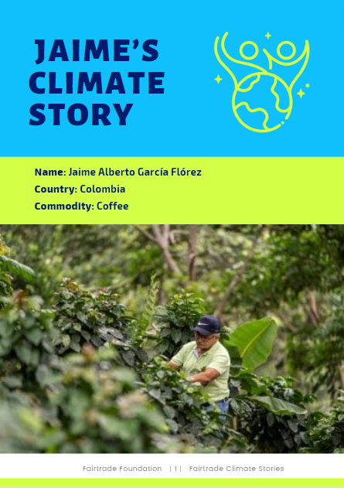
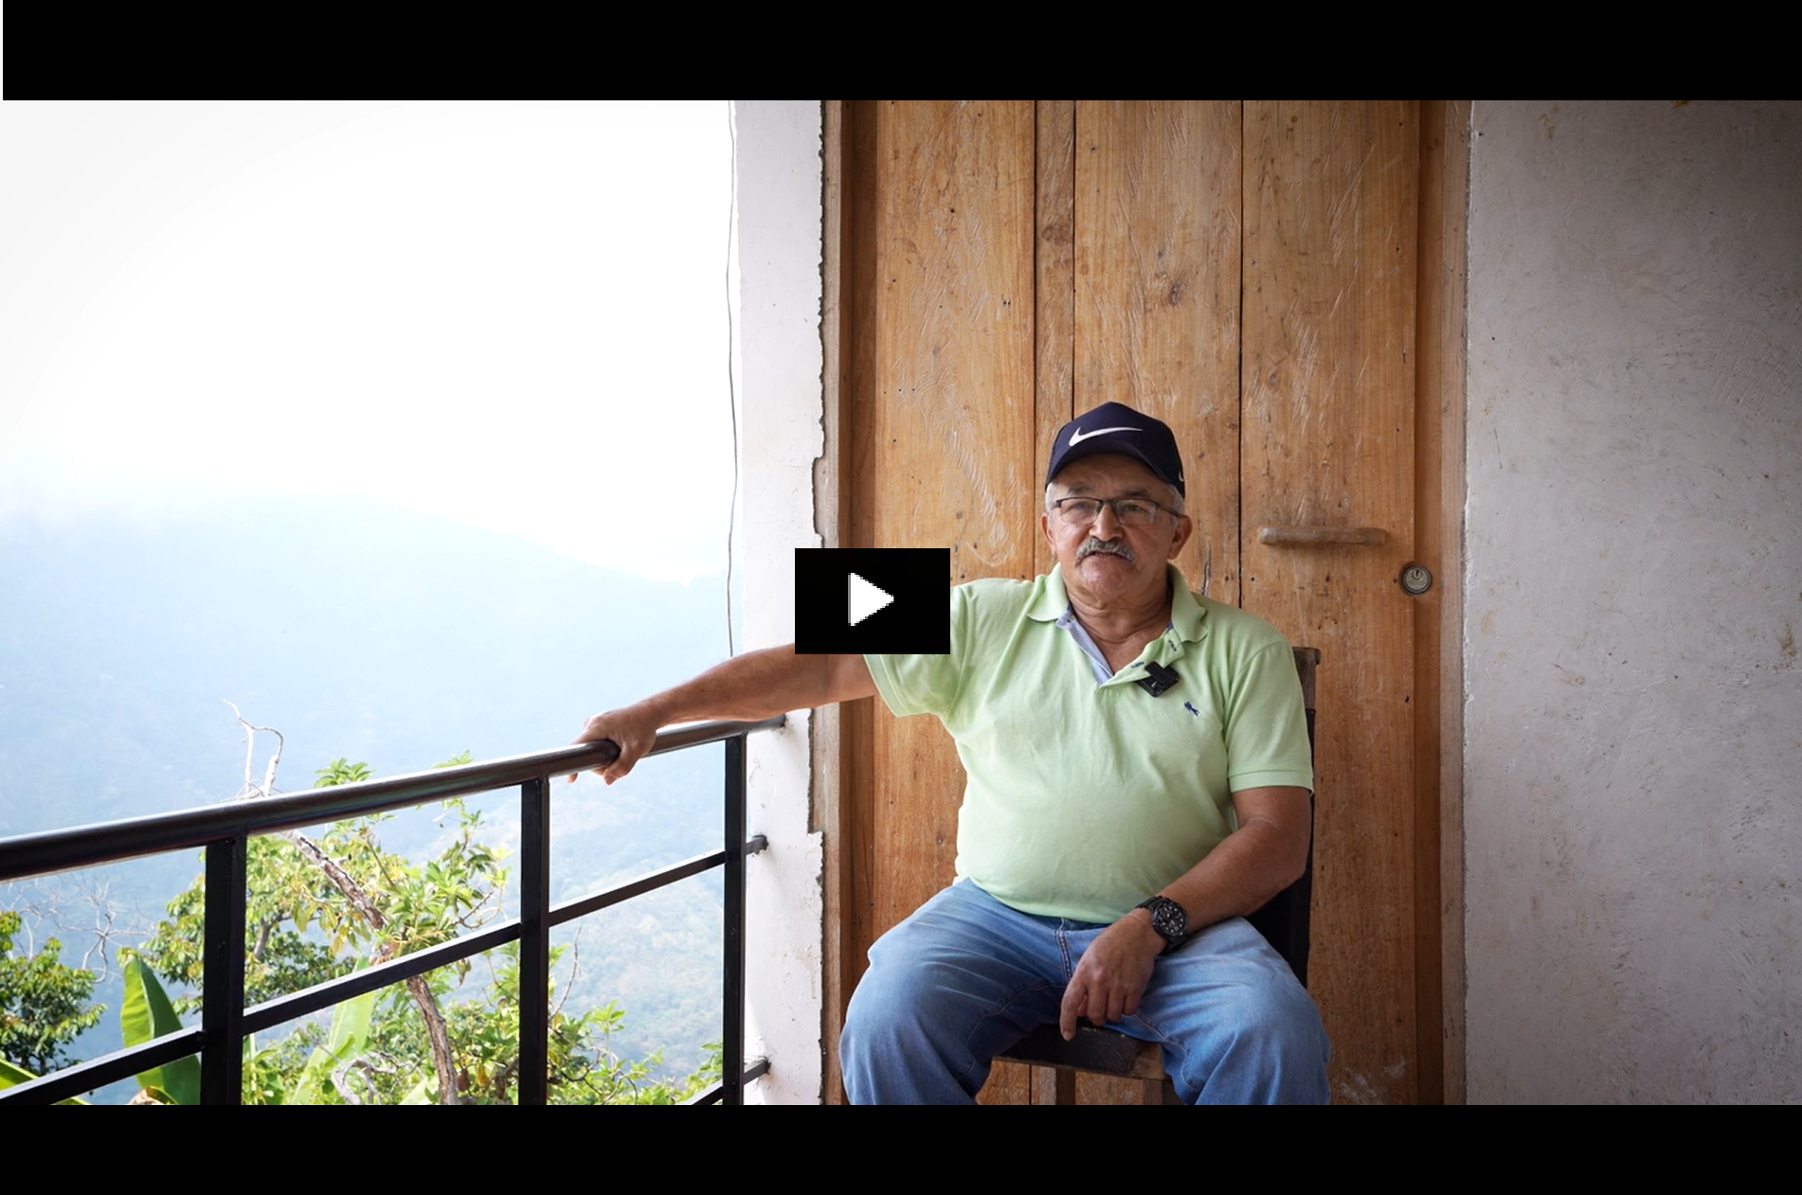

Slide 18
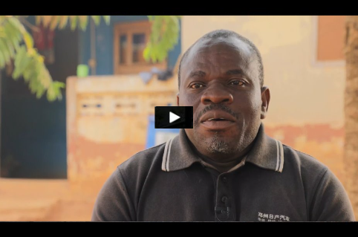

Slide 19
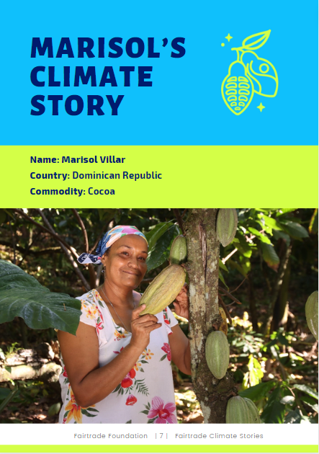
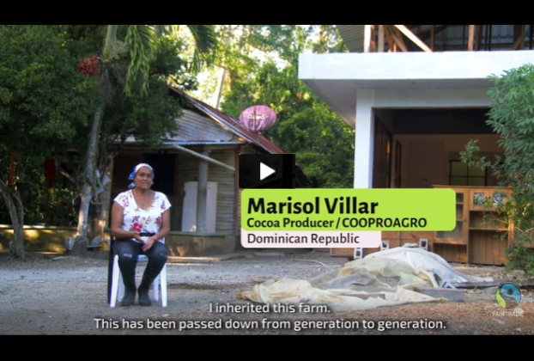

Slide 20
How can you support farmers to protect forests?
Notes:
Photograph of cotton farmer Kamalini Nayak in Bachaka village of Bhawanipatna, Orissa, India. Photographer: Ranita Roy, 2021.

Slide 21
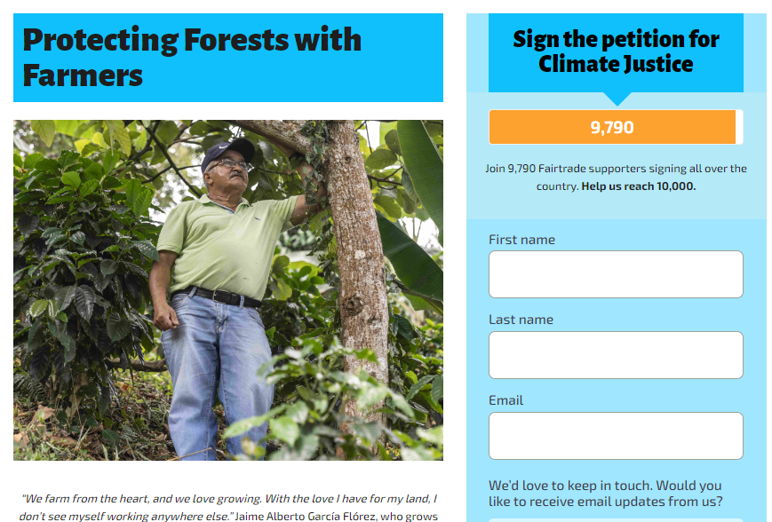
Take Action
Sign the petition
Sign the petition here:

Slide 22
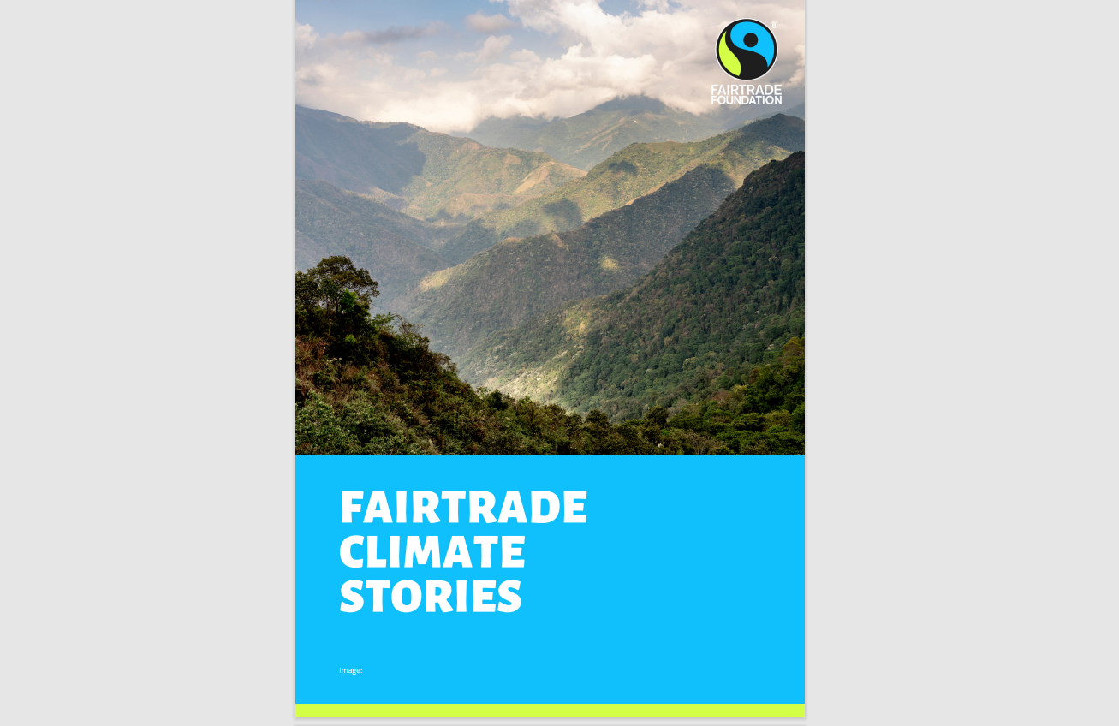
Take Action
Share our Spring Climate Stories

Slide 23
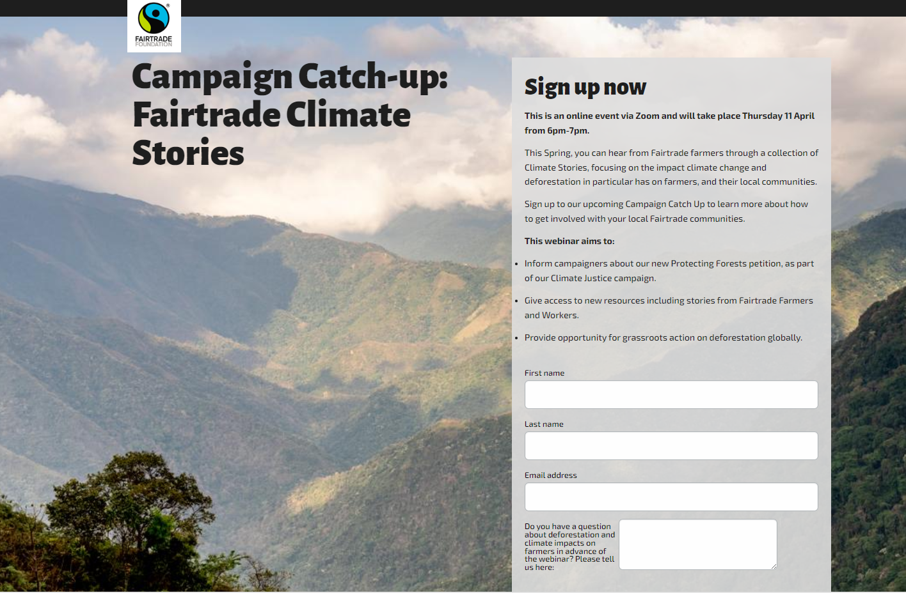
Take Action
Sign up to our teachers webinar

Slide 24
Key Fairtrade Climate Justice dates
Great Big
Green Week
8th – 16th June
Launch petition
25th March
JAN
FEB
MAR
APR
MAY
JUN
JUL
AUG
SEP
OCT
NOV
DEC
Spring Climate Stories
25th March- throughout April
COP 29
11th -22nd
November

Slide 25
Thanks!
Any questions?
You can find me at: hello@fairtrade.org.uk

