Slide 1


FAIRTRADE
FORTNIGHT
9TH-22ND SEPTEMBER
2024 TOOLKIT FOR MEMBERS OF PARLIAMENT

Slide 2

OVERVIEW
This Fairtrade Fortnight - between the 9th and the 22nd of September - Fairtrade presents: Be the Change.
This campaign is vibrant, positive and drives a deep, emotional message – with farmers and workers at the heart of the campaign.
Woven throughout this campaign is the global community of millions who have been working towards more responsibly produced and fairly priced goods, as part of a fairer world for all. This includes more than 2 million farmers and workers across 58 countries.
During this fortnight, we’re asking Members of Parliament to get involved by signing up to our pledge and committing to supporting fair trade.
We’d also like to invite you to our event in Parliament to show your support for fair trade:
Room W2 in Westminster Hall, Houses of Parliament
Tuesday 10th of September, 12-2pm
However big or small an action, we’re here to show people that they have the power to #BeTheChange.

Slide 3
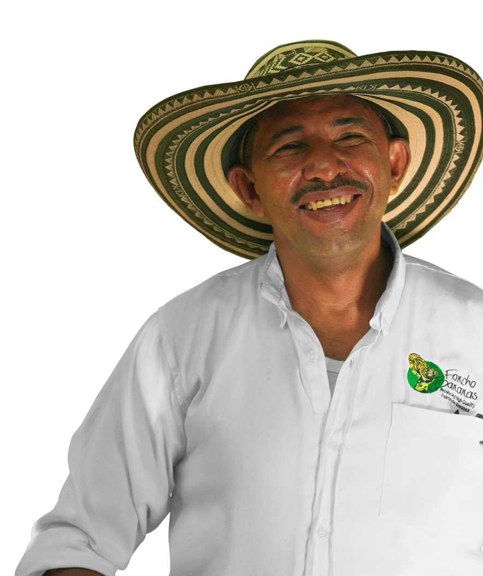

Sign to support fairer trade
THE BE THE CHANGE MP PLEDGE
The Be the Change pledge is a simple personal commitment to do everything you can as an MP to secure a fairer future for trade.
After you sign, we will send you suggestions on how you can get involved and celebrate your commitment on social media.
See the full wording of the pledge on the right.
‘I commit to working with fair trade campaigners in my constituency, and in Parliament, to support farmers and workers affected by unfair trade all around the world and to build a fairer future.’
I recognise that farmers and workers in lower-income countries urgently need fair pay and must be part of the conversations on how to tackle the poverty and climate crisis that threatens their future.
As an MP, I will do everything I can to make sure trade, development and climate policies contribute to this fairer future that benefits all.'
Foncho Cantillo
Banana farmer, Colombia

Slide 4

After you sign, celebrate your commitment!
Share your pledge on social media using our specially designed graphics
Please tag us on @fairtradeuk so we can reshare, and use the #BeTheChange hashtag.
Download the full-sized graphic here
Suggested post copy
I’ve pledged to #BeTheChange with @fairtradeuk because I know fairer trade matters to my community, and millions more around the word.
Find out how fairer pay and prices can drive change for farmers. Visit fairtrade.org.uk/bethechange #ChooseFairtrade

Slide 5

These assets can only be used during the period of Fairtrade Fortnight.
MORE SOCIAL MEDIA
TEMPLATES
You can also share these on your social media channels at any time during Fairtrade Fortnight to show your support for a fairer future
Please tag @fairtradeuk and use the #BeTheChange hashtag

Slide 6

SOCIAL MEDIA
TEMPLATES
Square posts
1080x1080px Canva templates
Post Copy
Buy Fairtrade today, so farmers can change their tomorrow. Find out how fairer pay and prices are driving change for farmers. Visit fairtrade.org.uk/bethechange. #BeTheChange #ChooseFairtrade
Post Copy
I’ve made a commitment to work with the whole Fairtrade movement - from local campaigners to Fairtrade farmers worldwide.
Find out how fairer pay and prices are driving change for farmers - visit fairtrade.org.uk/bethechange. #BeTheChange #ChooseFairtrade
Social media posts should refer to fairtrade.org.uk/bethechange and include #BeTheChange #ChooseFairtrade

Slide 7

SOCIAL MEDIA
GRAPHICS
MP Pledge sharing graphic rectangular
1920x1080px PNGS
Social media posts should refer to fairtrade.org.uk/bethechange and include #BeTheChange #ChooseFairtrade

Slide 8


SOCIAL MEDIA
GRAPHICS
Post Copy
Bengaly Bourama is a cocoa farmer at COOBADI Co-operative in Côte d’Ivoire. COOBADI became a Fairtrade cooperative in 2014, and since then they have distributed 25,000 shade tree saplings to help provide shade to cocoa trees that are trying to establish
amid the increasing prevalence of drought and disease.
Find out how the Fairtrade Premium is driving change for farmers at fairtrade.org.uk/bethechange. #BeTheChange #ChooseFairtrade
Producer story square posts
1080x1080px PNGs
Post Copy
Kouassi Affoué Angèle is a cocoa farmer at ECAMOM cooperative, Côte d’Ivoire.
The Fairtrade Premium supports her cooperative to cover their costs so that they don’t have to take out loans. Together with Fairtrade, Kouassi has also taken training about women’s rights, negotiation and leadship.
Find out fairer pay and prices are driving change for farmers at fairtrade.org.uk/bethechange. #BeTheChange #ChooseFairtrade
Social media posts should refer to fairtrade.org.uk/bethechange and include #BeTheChange #ChooseFairtrade

Slide 9
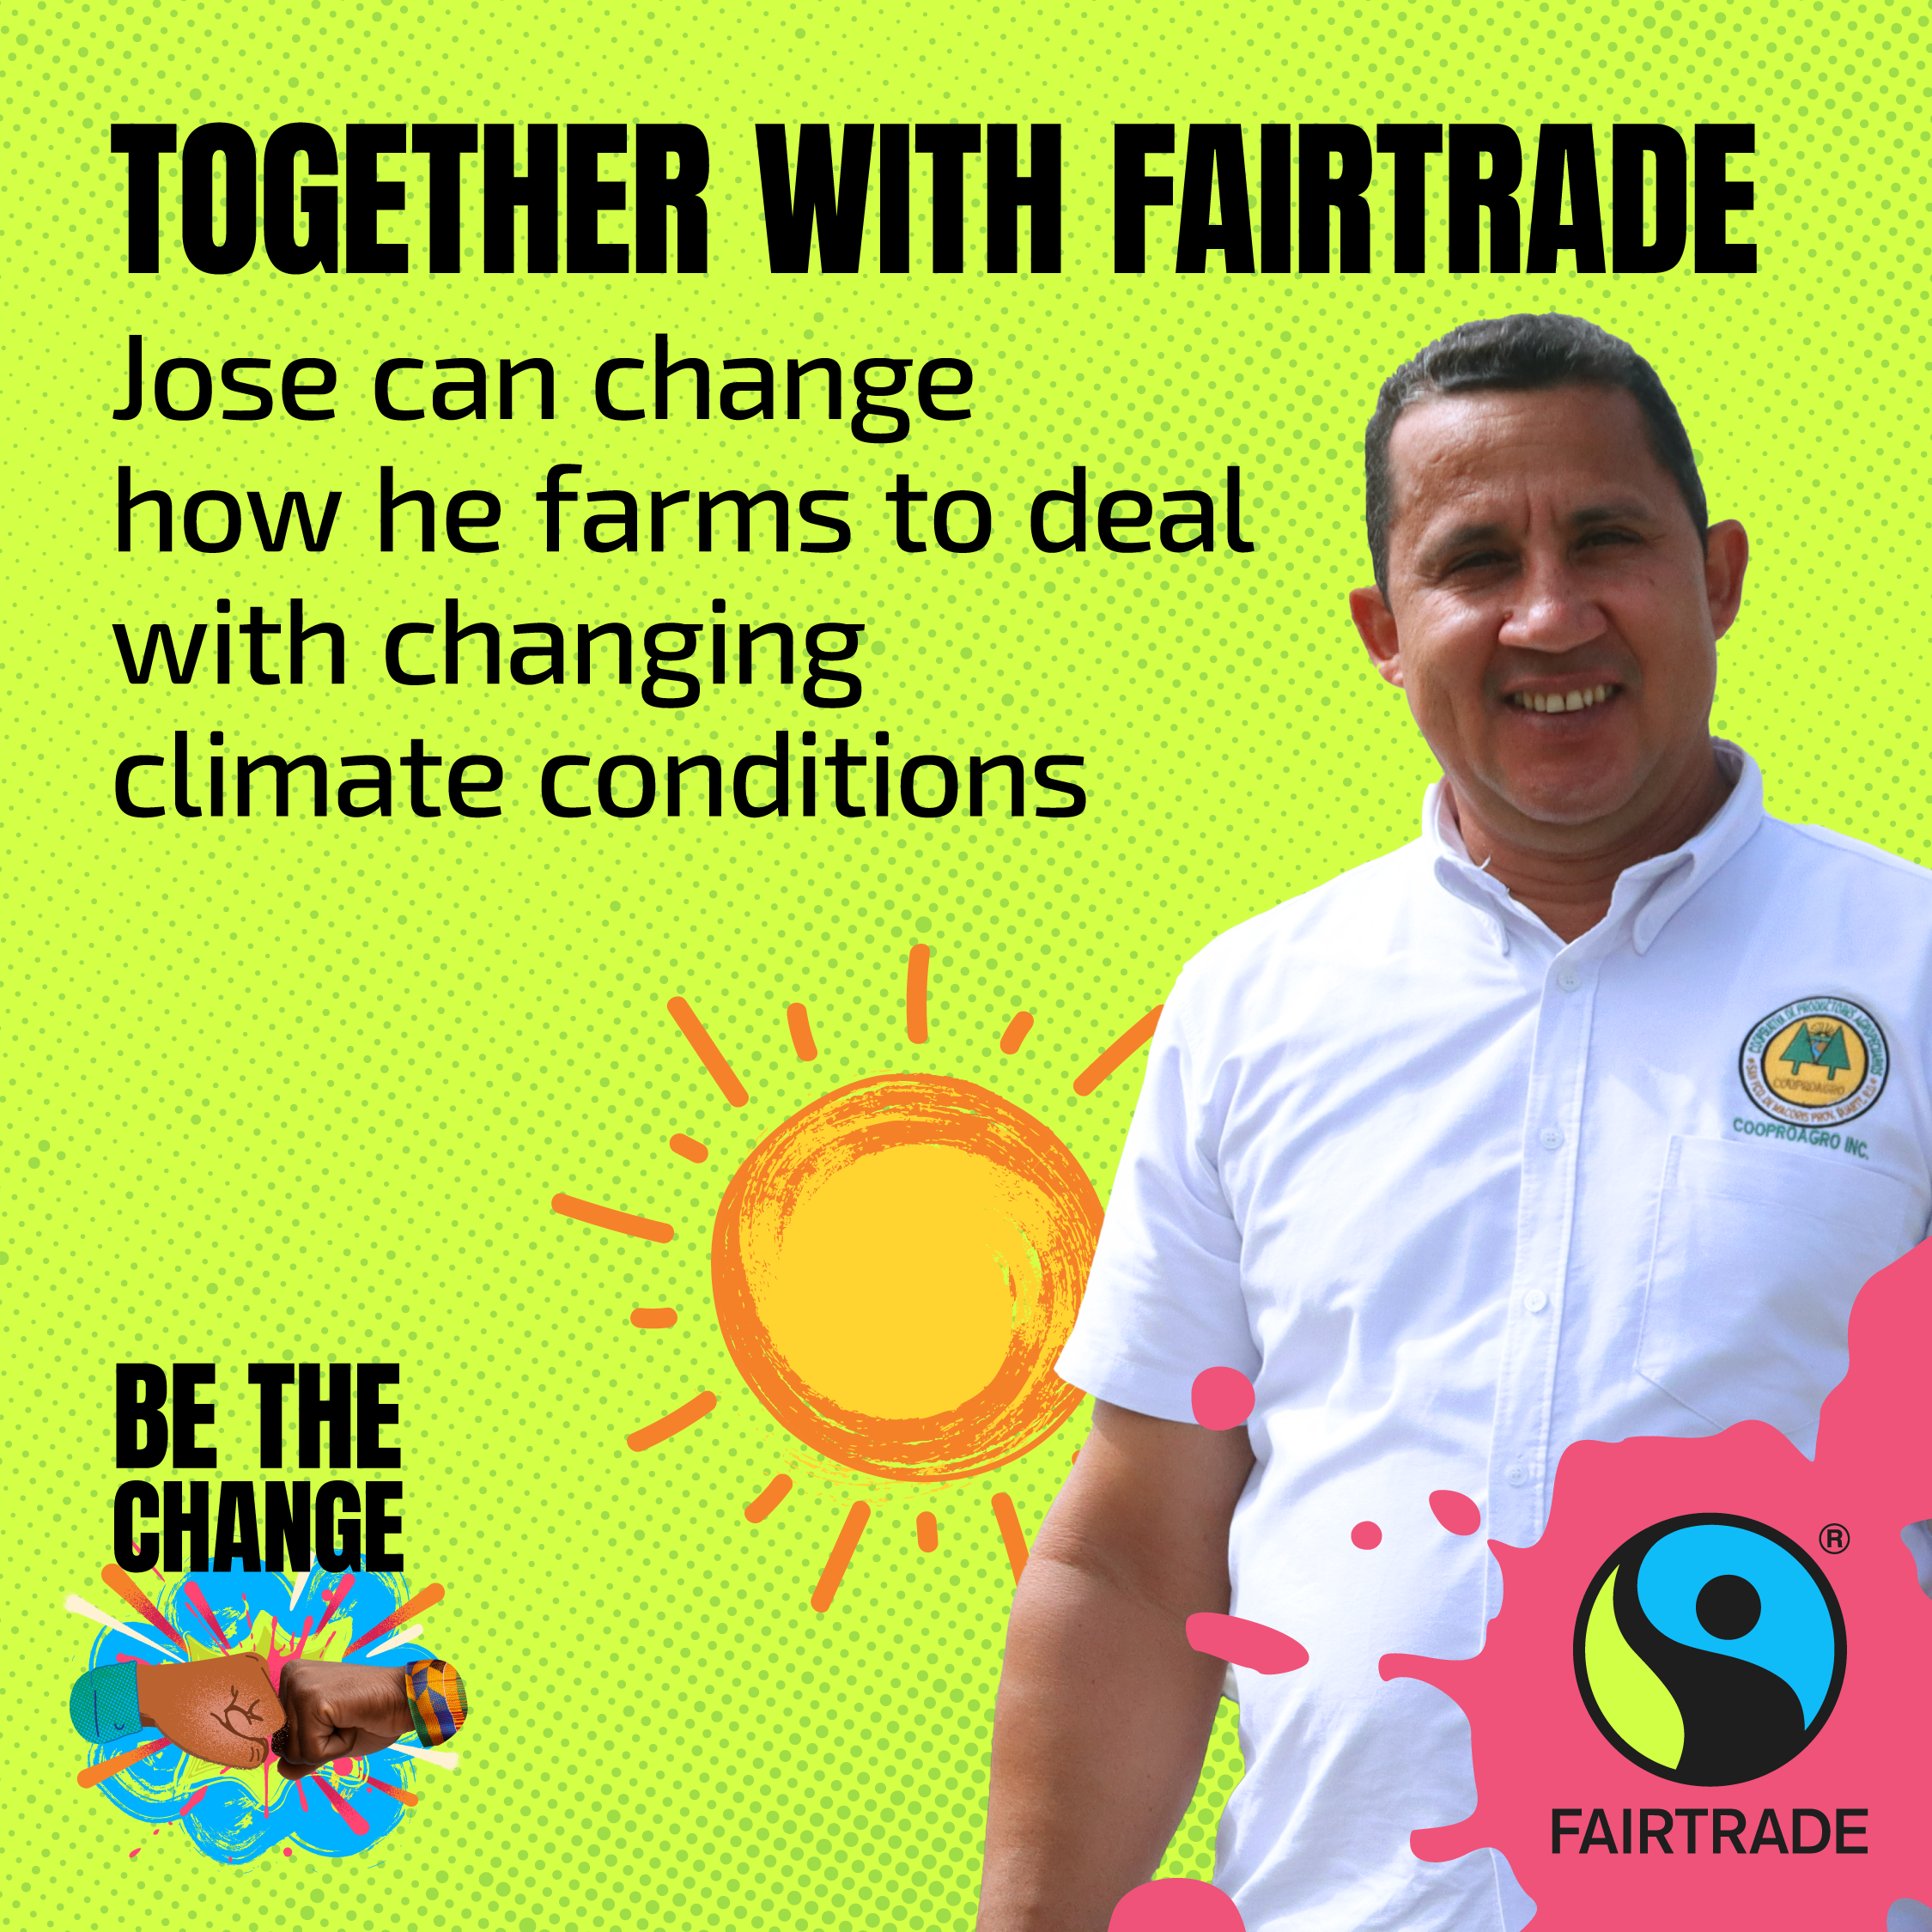

SOCIAL MEDIA
GRAPHICS
Post Copy
Jose Nicolas Ortiz is a cocoa farmer and Project Manager at Cooproagro Cooperative in the Dominican Republic.
Using the money generated from the Fairtrade Premium, the cooperative can run projects and programmes that aim to reduce the effects of the climate emergency on
cocoa harvests.
Find out how the Fairtrade Premium is driving change for farmers at fairtrade.org.uk/bethechange. #BeTheChange #ChooseFairtrade
Producer story square posts
1080x1080px PNGs
Post Copy
Albeiro Alfonso Cantillo (known as Foncho) is a banana farmer at the Coobafrio Co-operative in Colombia who now sends his daughter to university.
The increased incomes & local employment, as well as the social projects funded by the Fairtrade Premium, have strengthened the cooperative’s standing in the local community. The co-operative’s Education Fund has supported 82% of members in paying for school fees, uniforms, equipment and other costs.
Find out how fairer pay, prices and the Fairtrade Premium are driving change for farmers at fairtrade.org.uk/bethechange. #BeTheChange #ChooseFairtrade
Social media posts should refer to fairtrade.org.uk/bethechange and include #BeTheChange #ChooseFairtrade

Slide 10

HOW TO
PARTICIPATE

Slide 11
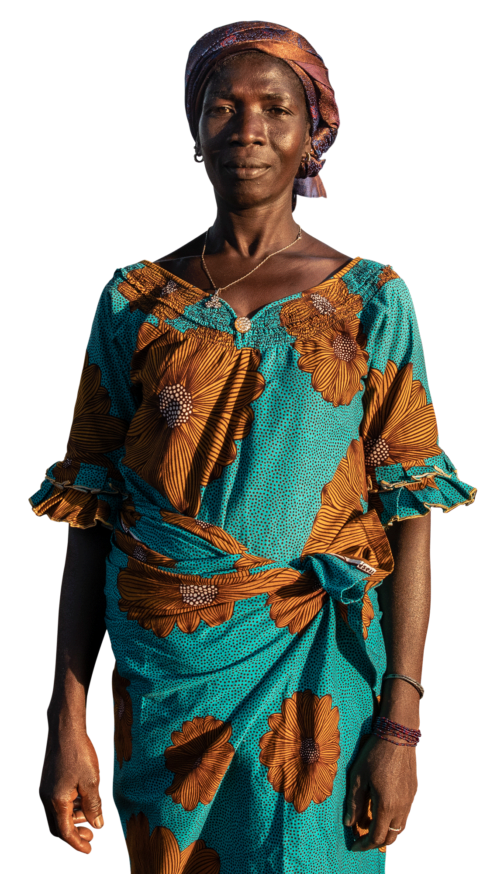

HOW TO PARTICIPATE
As well as signing up to our pledge, you can push our message out to the world! If you need a hand on how to do it, we’re always here to give you some help.
Attend our event in Parliament on Tuesday 10th of September, 12-2pm, to show your support for fair trade
Attend events organised by the community in your constituency
Share that you’ve signed up to our pledge on your social media channels, using the assets in this toolkit
Share other assets from our toolkit about Be The Change campaign, making sure to tag us and use #BeTheChange and #ChooseFairtrade
In addition to our ready-to-use assets, there are other opportunities to get involved. Get in touch for more info.
Yeo Fannidianwa
Shea nut farmer, Côte d'Ivoire

Slide 12
These assets can only be used during the period of Fairtrade Fortnight.
PRINT
RESOURCES

Slide 13

PRINT
RESOURCES
Generic A4 poster
A4 (297x210mm) PDF

Slide 14

PRINT
RESOURCES
MP Pledge poster
A4 (297x210mm) PDF

Slide 15

GET IN TOUCH

Slide 16
GET IN TOUCH
Contact Information
For more information on the campaign or to ask any questions, please contact Alexander Carnwath:
alexander.carnwath@fairtrade.org.uk
For any artwork questions
or artwork approvals, please email:
artwork@fairtrade.org.uk

