Slide 1
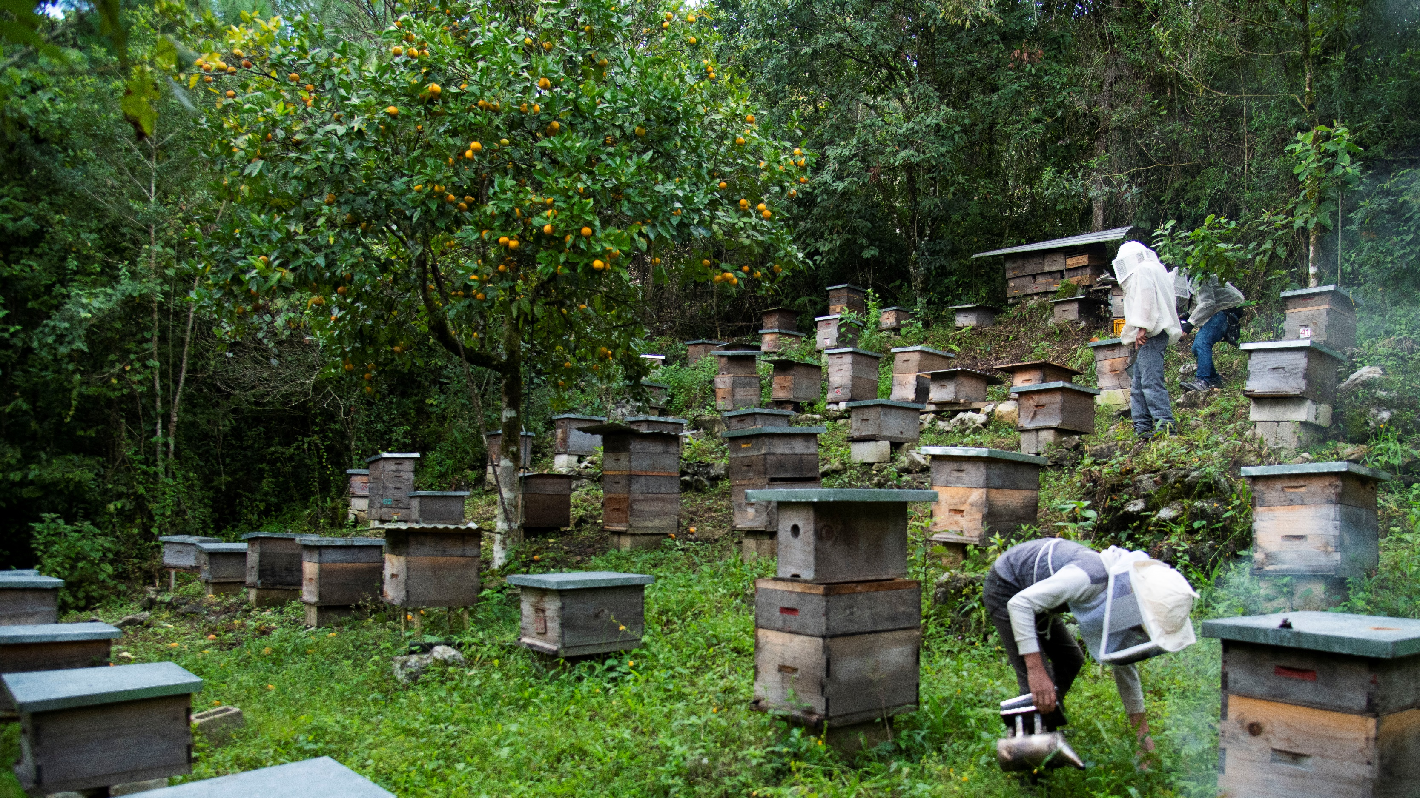
Innovative Interventions
Participant support for achieving your
Fairtrade University & College Award

Slide 2
Welcome
Elena Fernandez-Lee, Education Campaign Manager
Sarah Hazlehurst, Campaign Manager

Slide 3
Agenda
What are 'Innovative Interventions'?
The criteria wording and marks
Case studies
Group discussion/Q&A

Slide 4
What are "Innovative Interventions"?
A guide to the criteria

Slide 5
Innovative Interventions
Fairtrade is about more than just selling Fairtrade products; it's about transforming systems to support ethical trading, environmental sustainability, and social equity.
The Innovative Interventions criteria rewards creative and novel approaches to these complex challenges. These approaches may include anything from hosting joint events with other universities, interdisciplinary work between different University departments, keeping up to date with global trends and initiatives.

Slide 6
Innovative Interventions
II1,2,3 – 15 marks
Use this section to tell us about innovative actions or initiatives that you have done within your Fairtrade, ethical consumption or trade justice work which you think are worthy of recognition.
II4 – 15 marks
Use this section to tell us about innovative actions or initiatives that you have taken or developed within your Fairtrade, ethical consumption or trade justice work which have a sector-wide impact, or potential to reach wider than just your institution and union.

Slide 7
Innovative Interventions
Marking
Half marks
General ethical consumption
Full marks
-Fairtrade/ trade justice/ social justice
Other considerations
Building on previous criteria vs reusing evidence.
The scale/ impact of your interventions.

Slide 8
Case studies
Examples of brilliantly innovative interventions

Slide 9
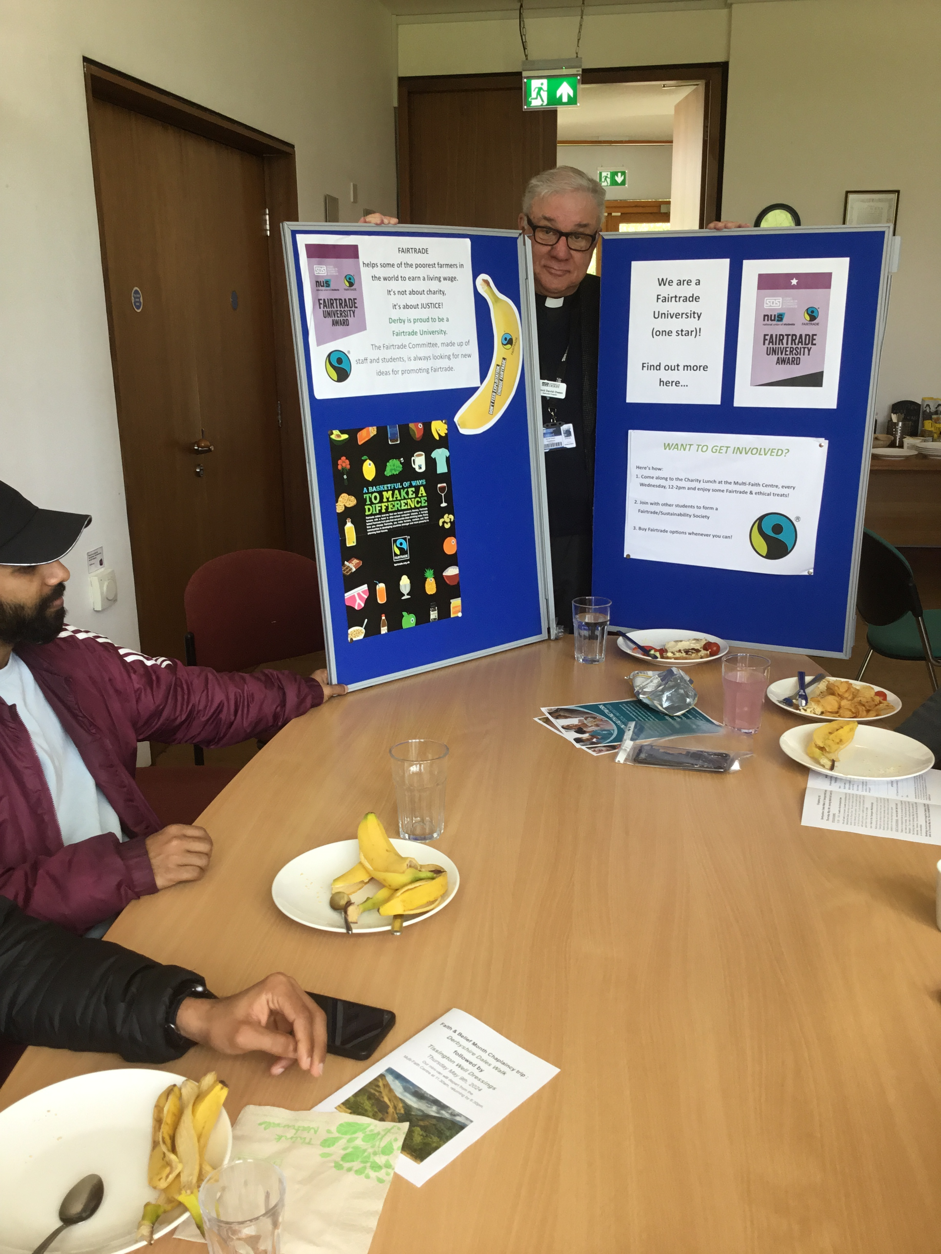
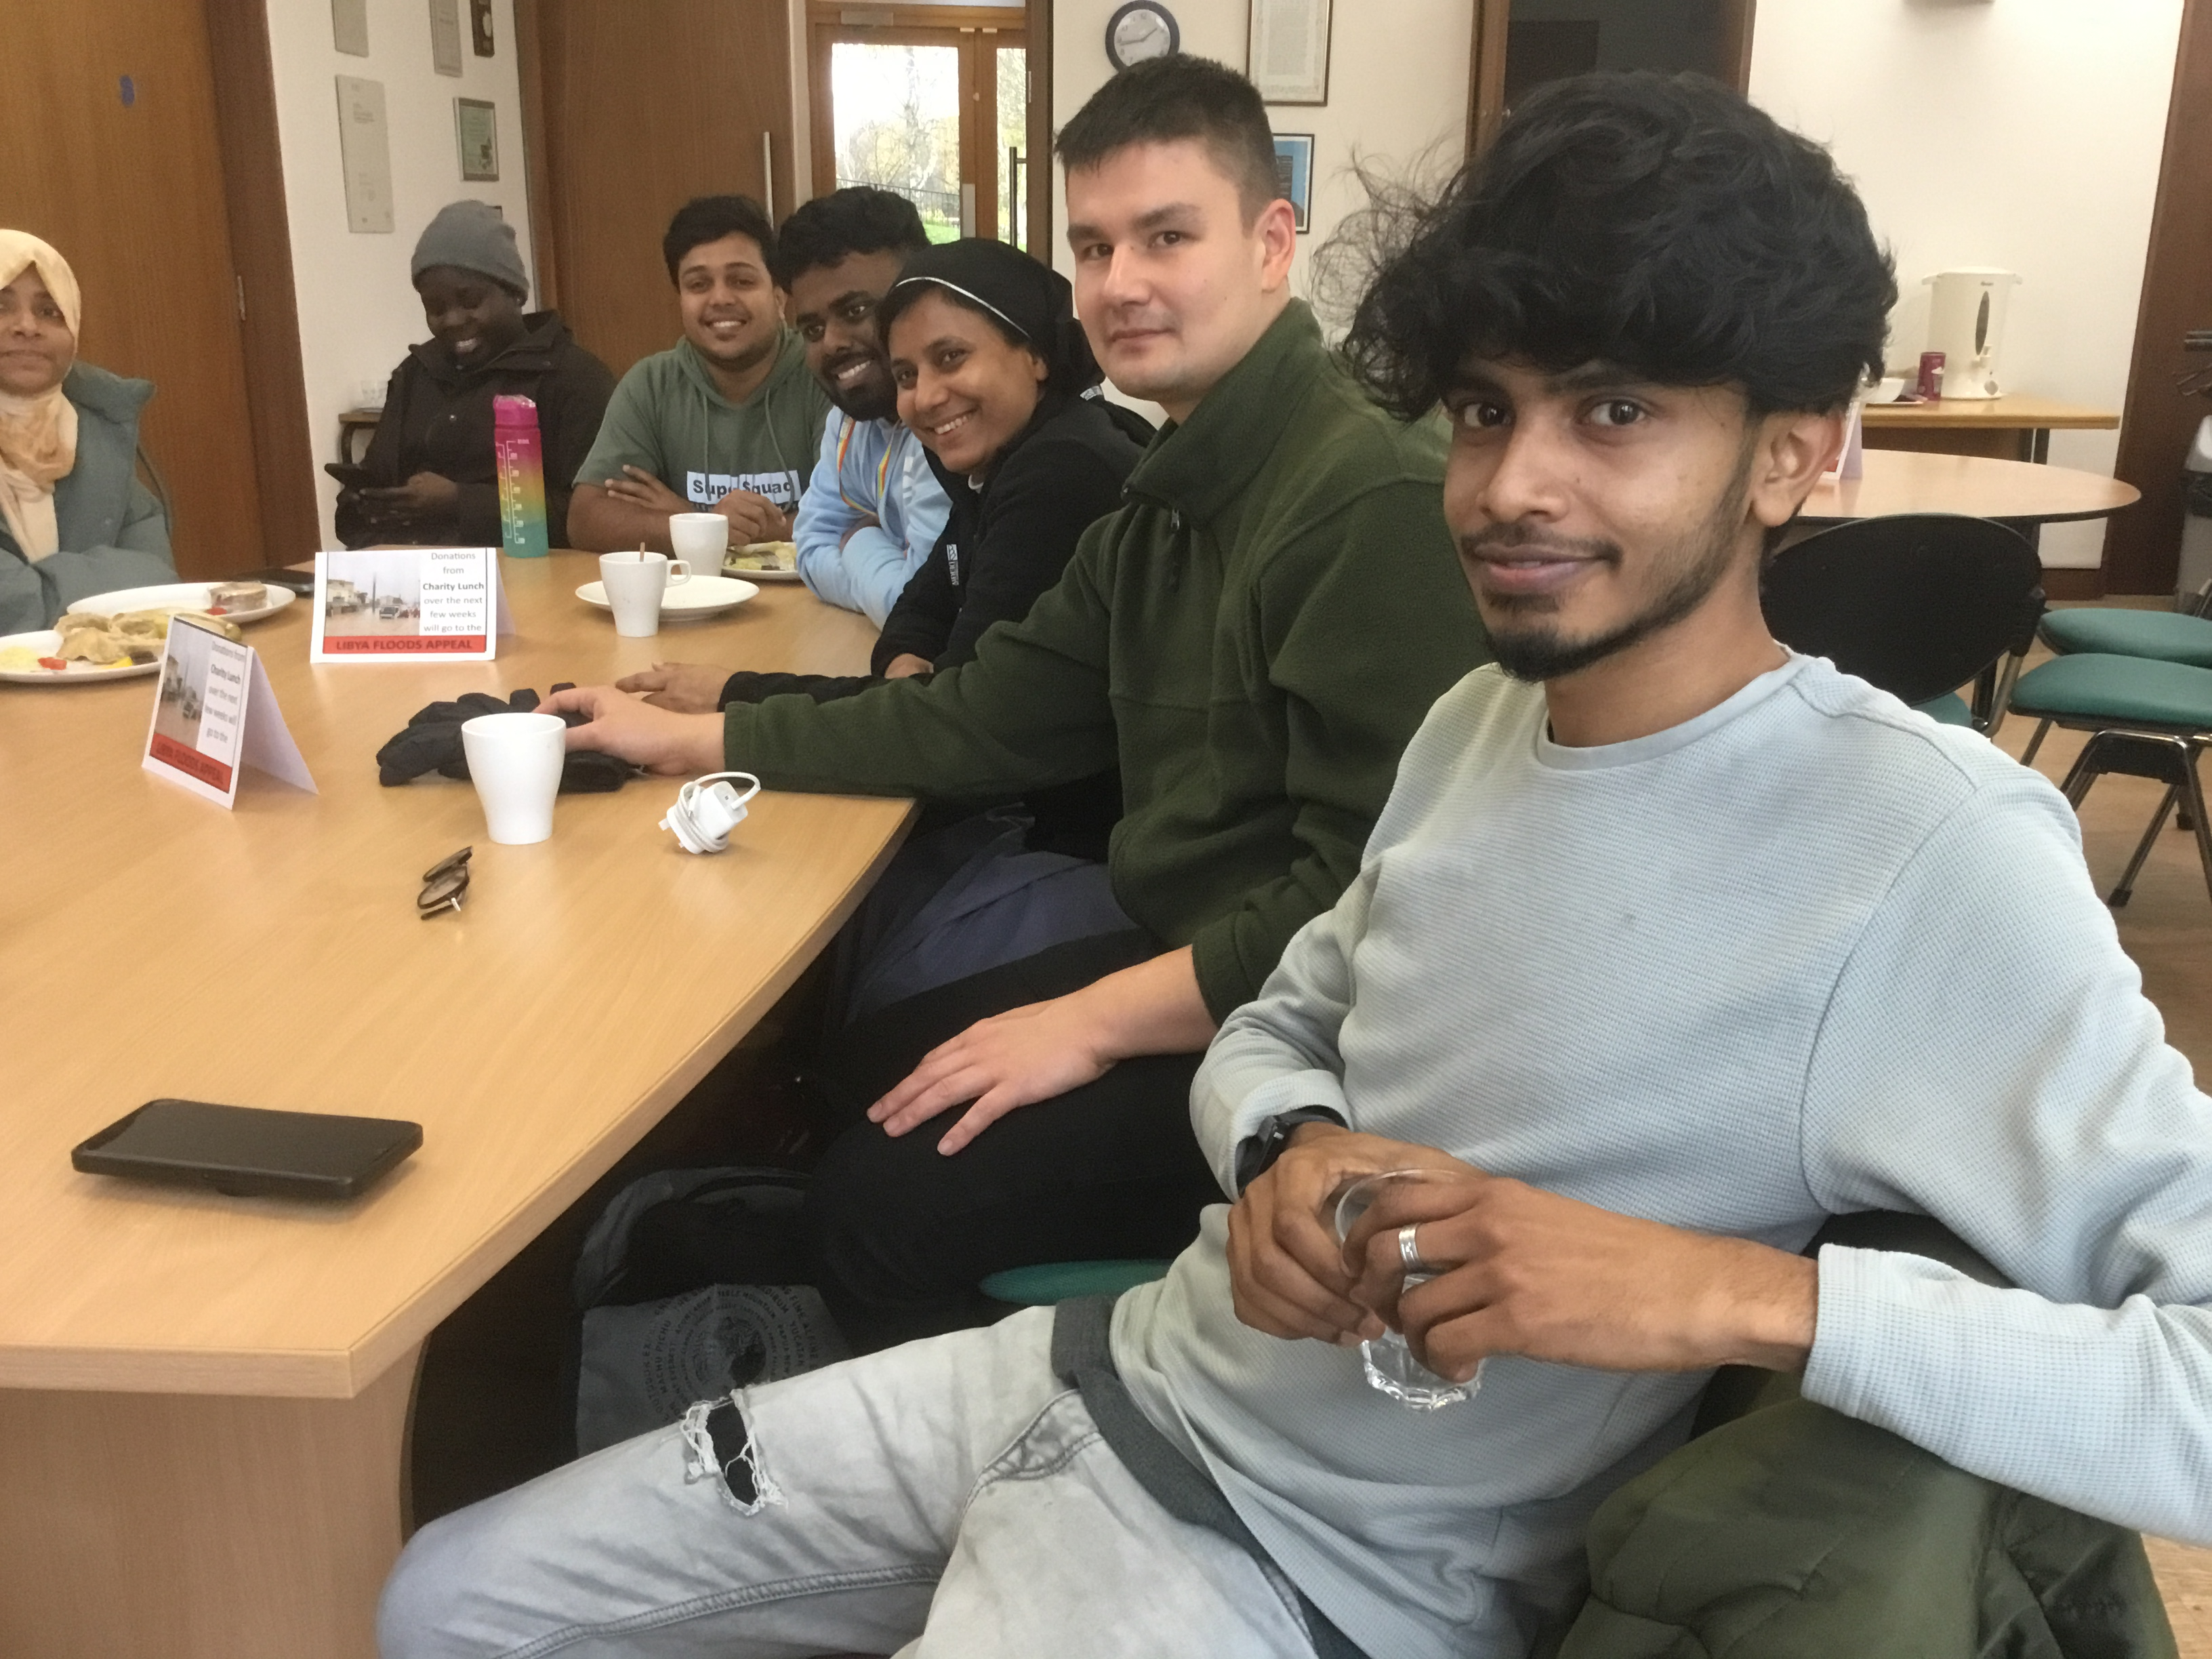
Case study 1 – University of Derby Fairtrade Lunches

Slide 10
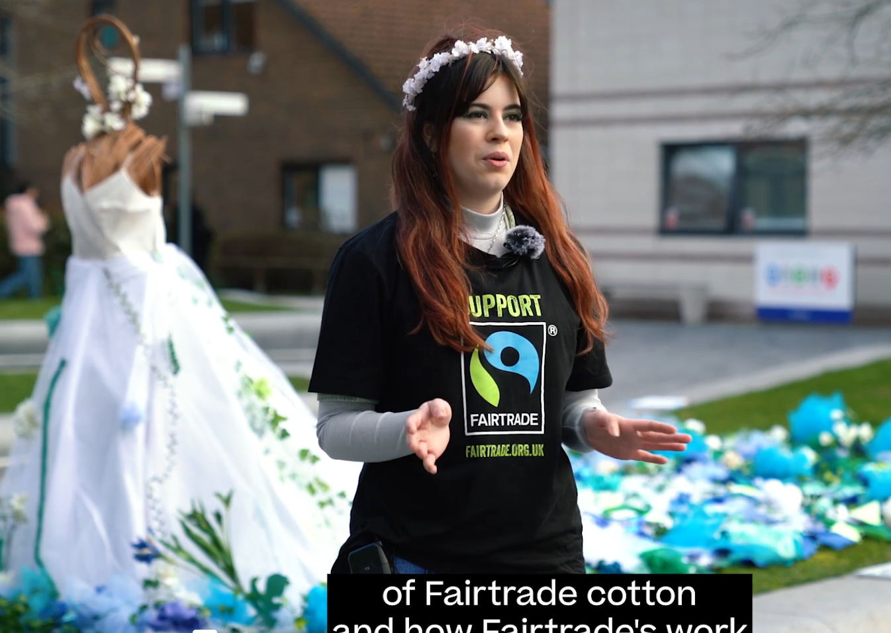
Case Study 2: Bournemouth Arts University end of year art exhibition
Fairtrade Fortnight at AUB on Vimeo

Slide 11
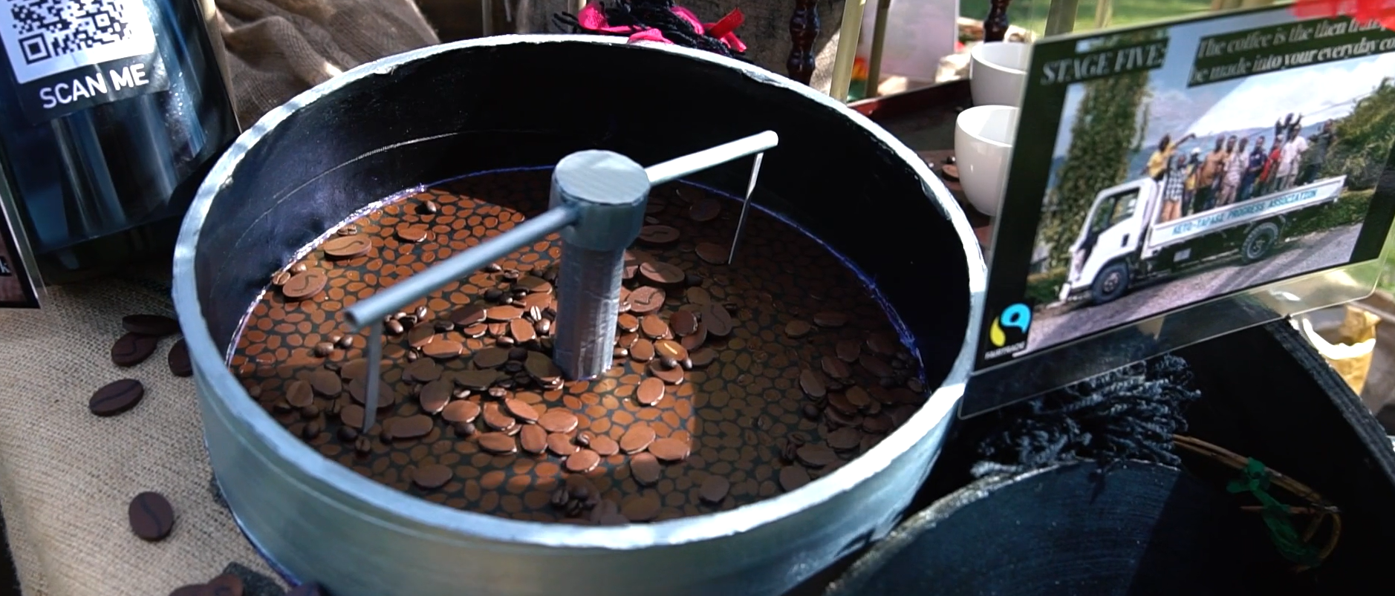

Slide 12
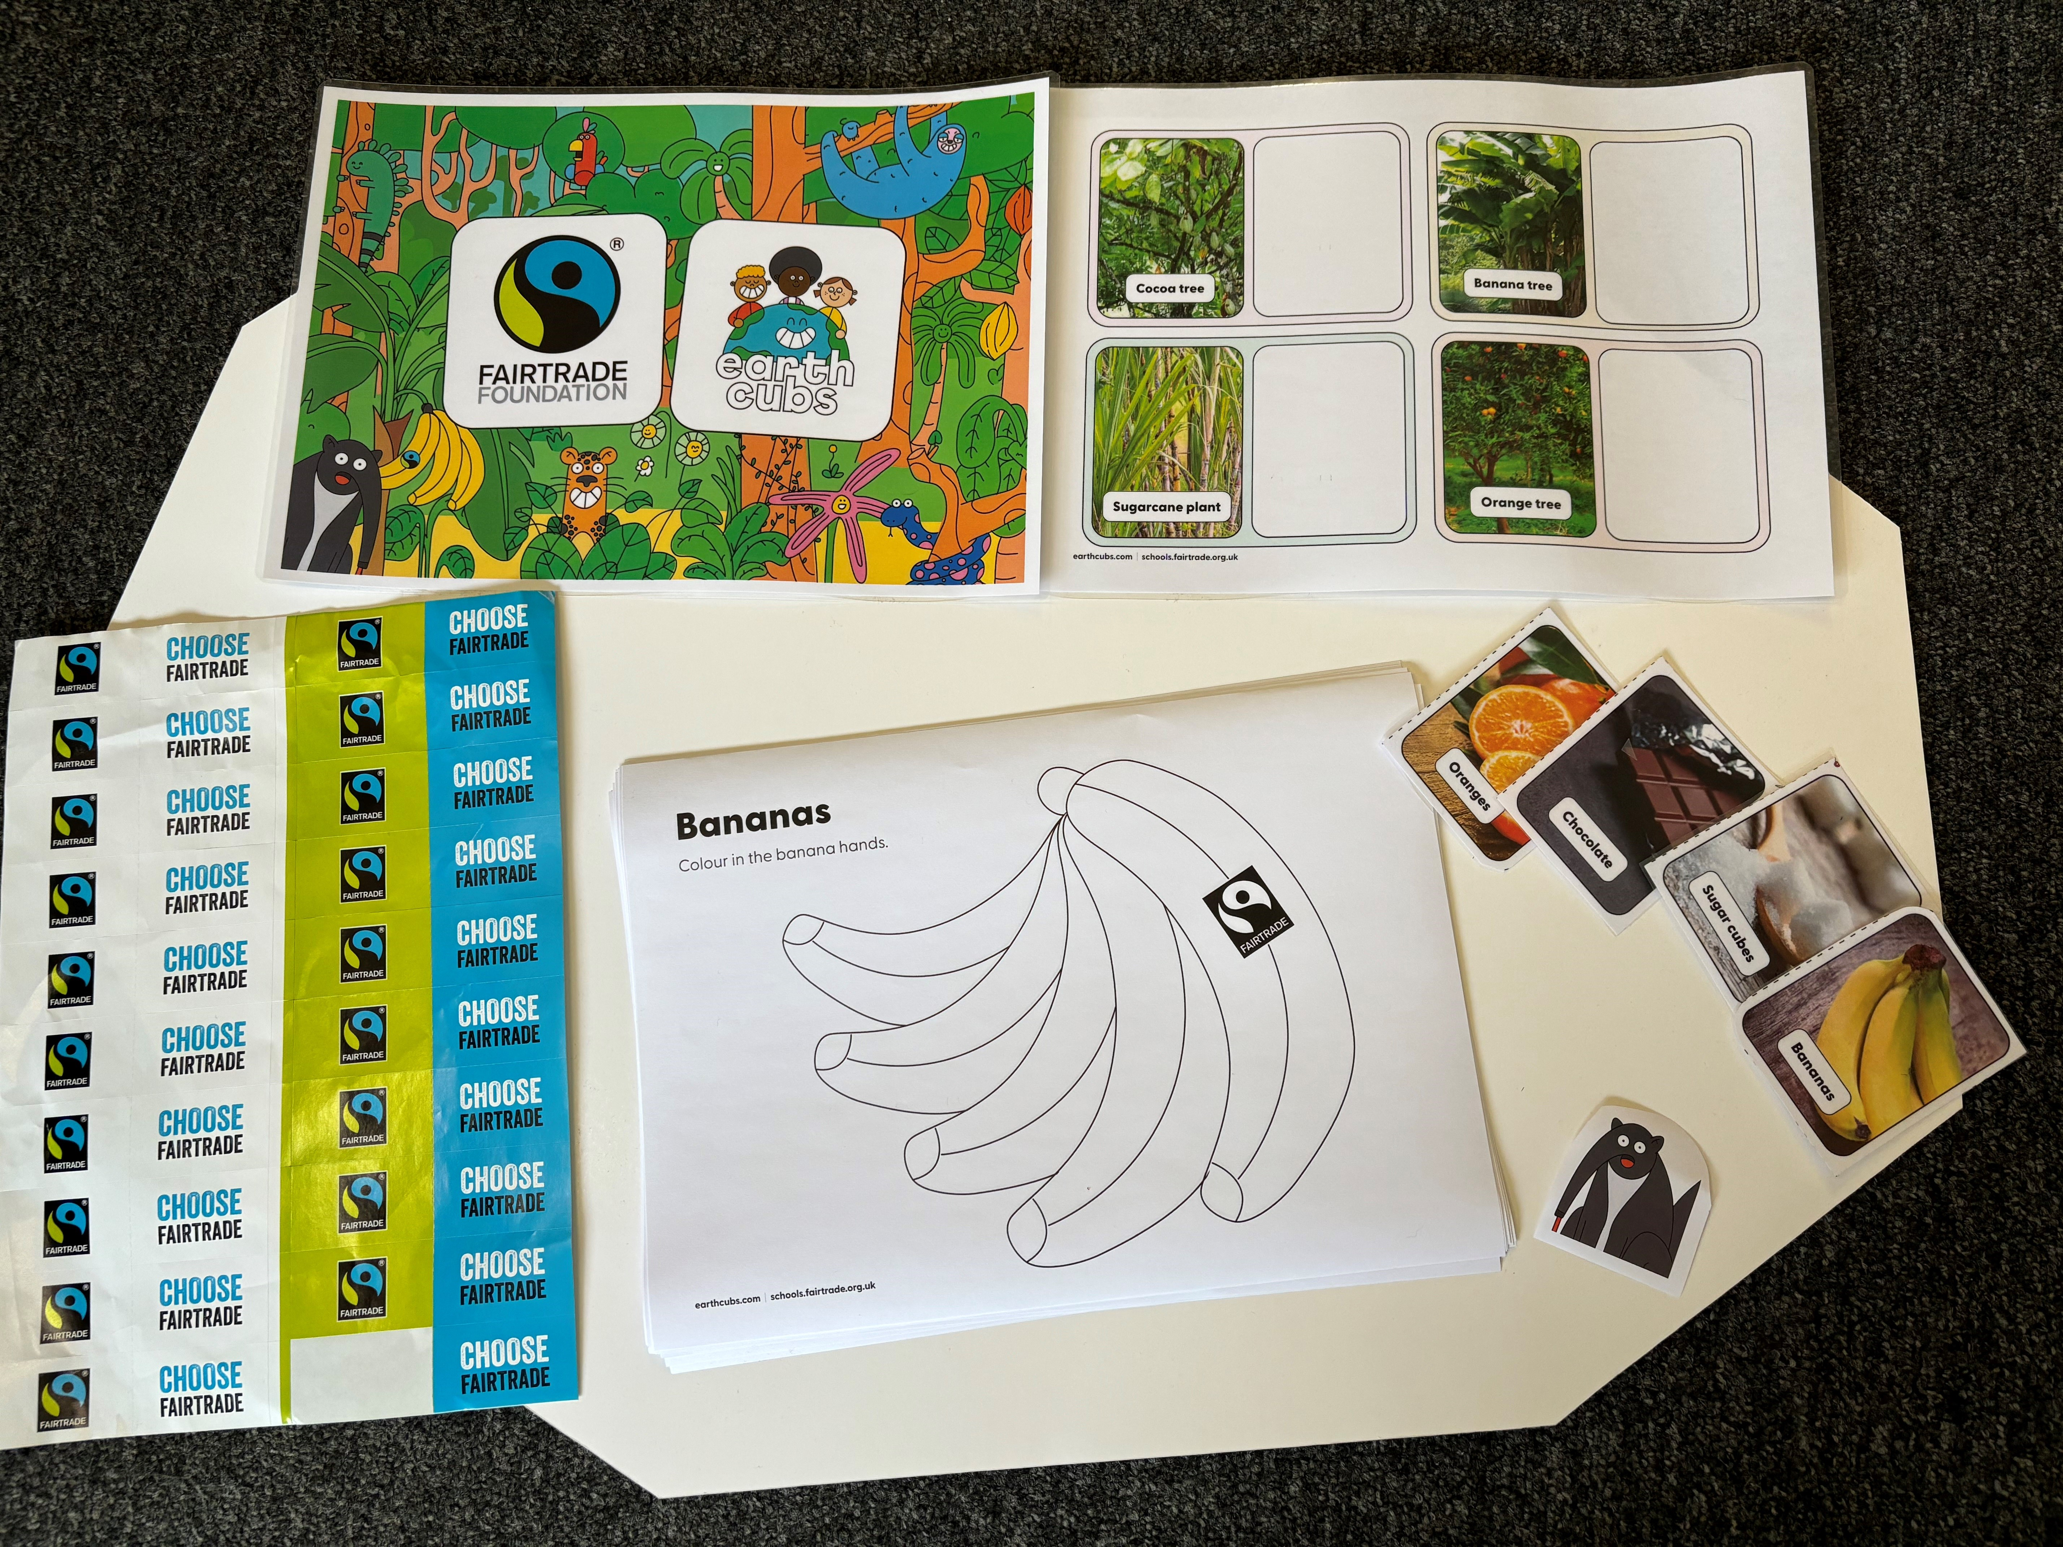
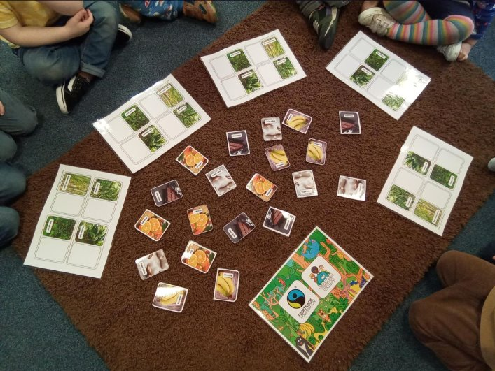
Case Study 3: University of Plymouth Nursery

Slide 13
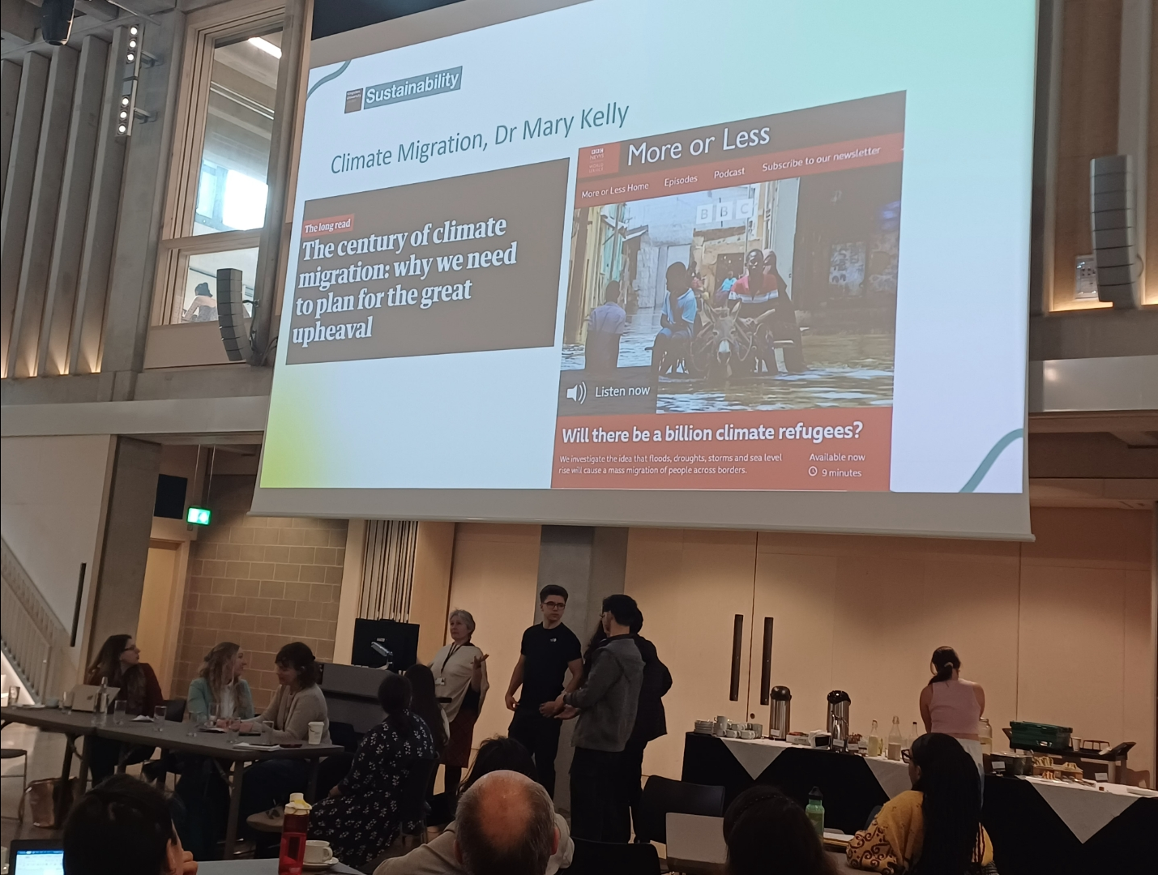
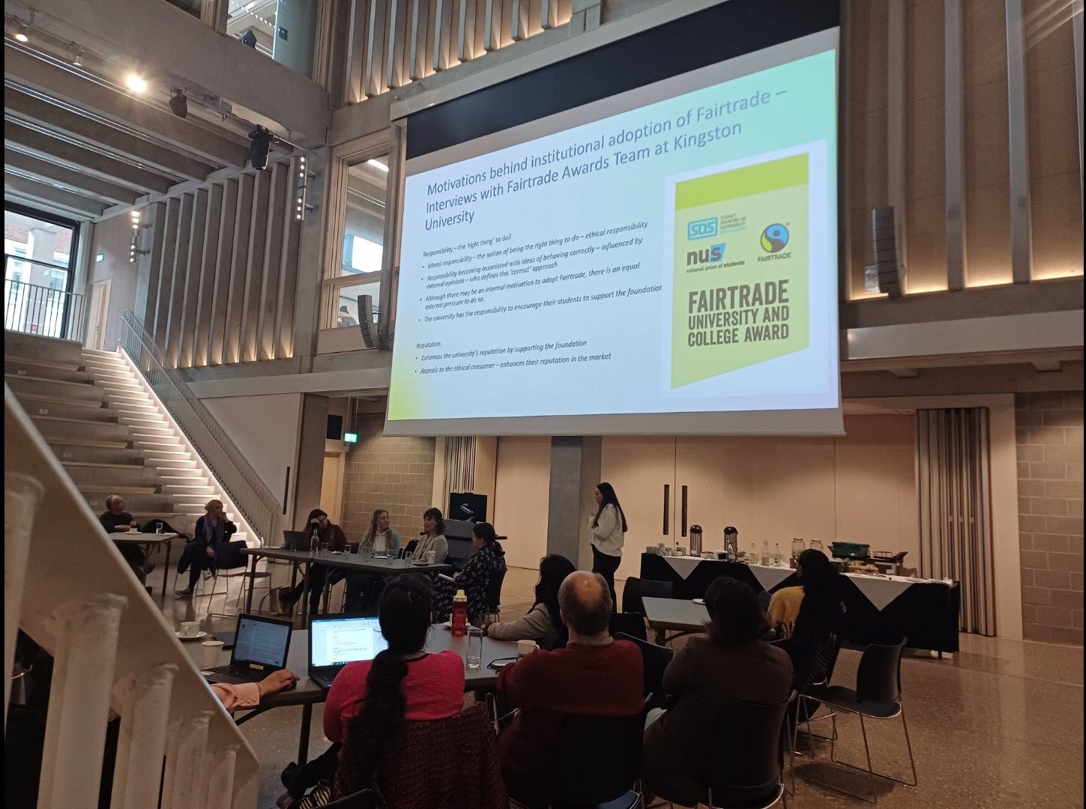
Case Study 4: Kingston University Roundtable discussion

Slide 14
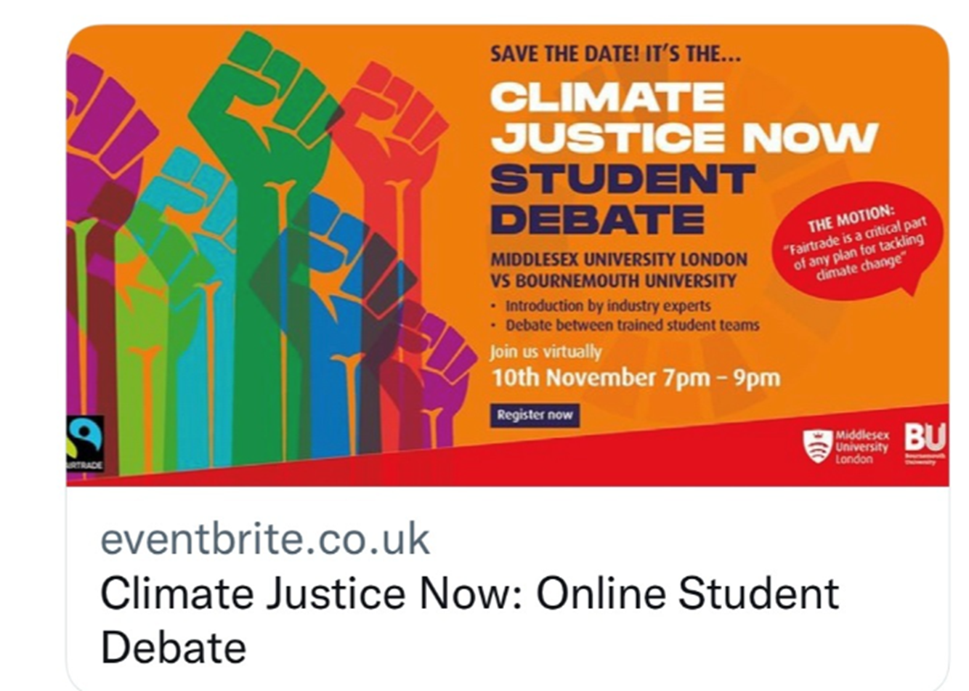
Case study 5: Middlesex & Bournemouth Universities "Climate Justice Now!" programme

Slide 15
Thanks!
Any questions?

